Slide 1
Structural Pest Control and the Brown Marmorated Stink Bug

Slide 2
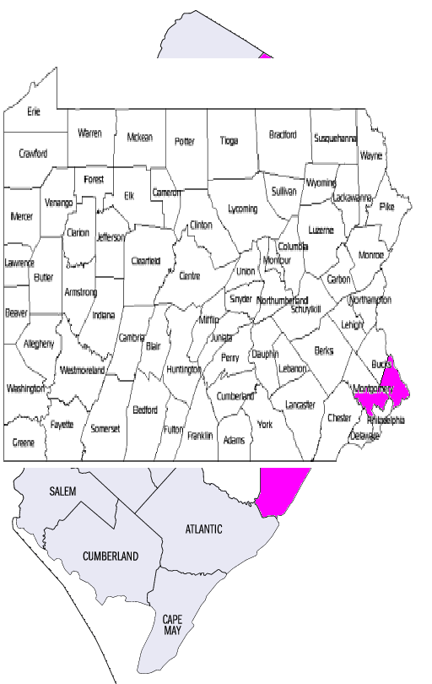
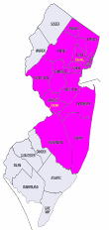
Cooper Pest Solutions

Slide 3
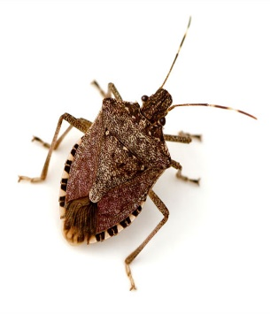
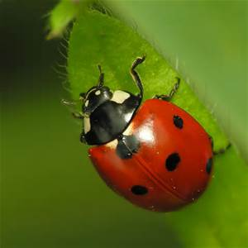
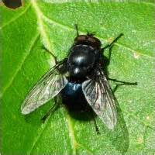
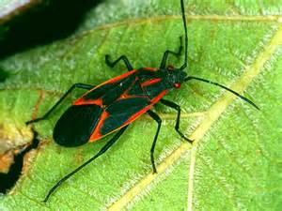
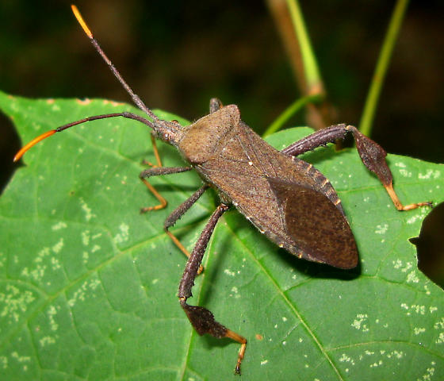
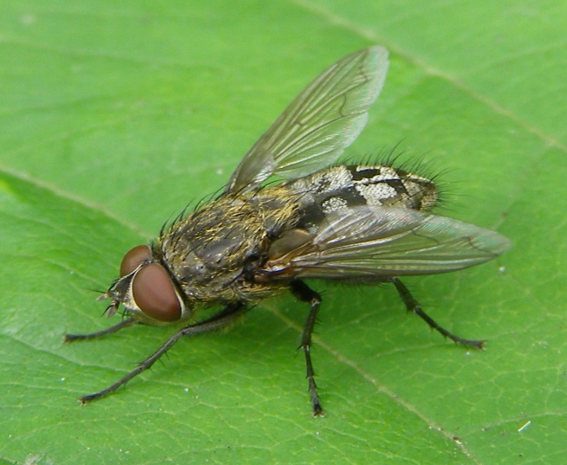
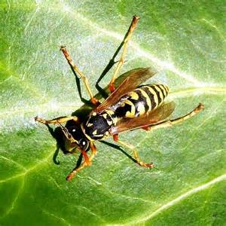
Stink bugs and other overwintering pests
Stink Bugs
Lady bugs
Cluster flies
Black Blow Flies
Leaf footed bugs
Boxelder bugs
Wasps

Slide 4
BMSB is Different Than Other Over-wintering Pests!
Enter earlier and leave later than other over-wintering pests
Active throughout entire winter
Get into people’s stuff - clothes, bed sheets, in boxes, amongst piles of papers, etc.. (becomes infuriating)
Very active at night and attracted to lights (disruptive & creates anxiety)
Any bugs are problematic in sensitive environments (i.e. hospitals, FDA & USDA regulated facilities, etc.)
They’re ugly and they stink.

Slide 5
When to treat?
Clients don’t call till they see them…. Too late!
Services have to be performed before the bugs enter the structure

Slide 6
Entry point Treatment areas

Slide 7
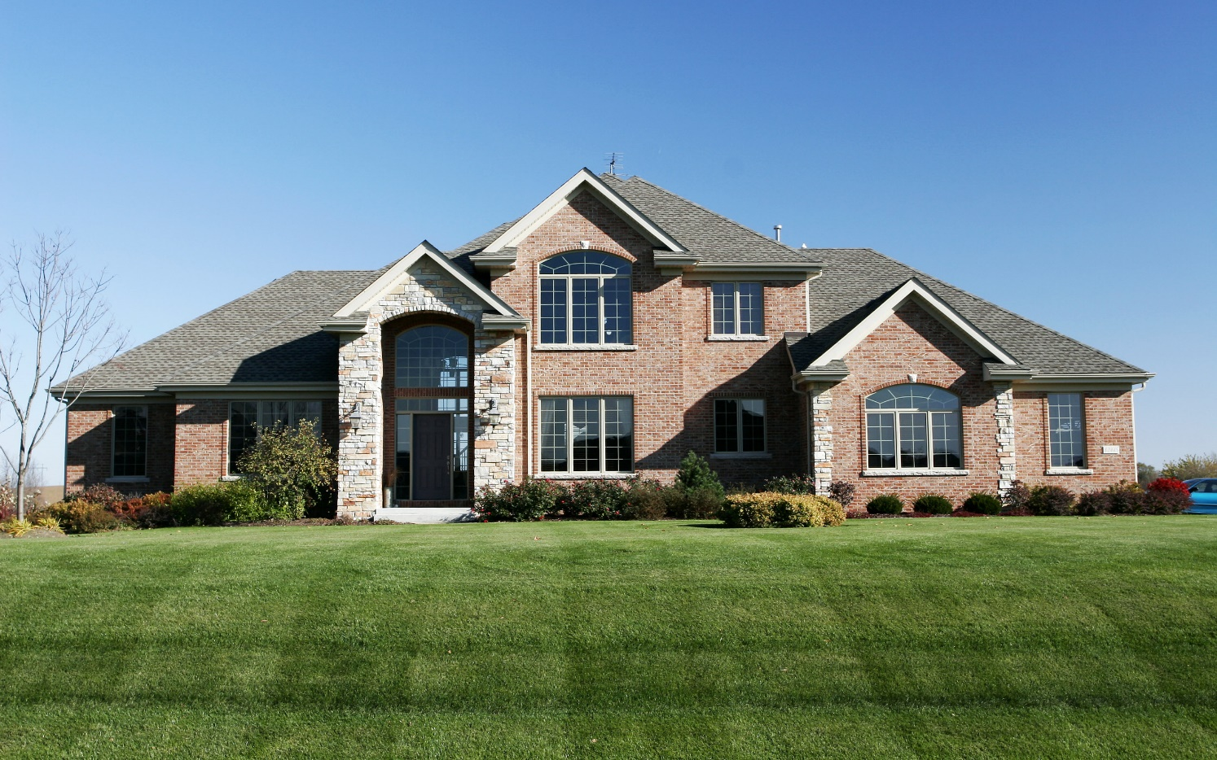

Slide 8
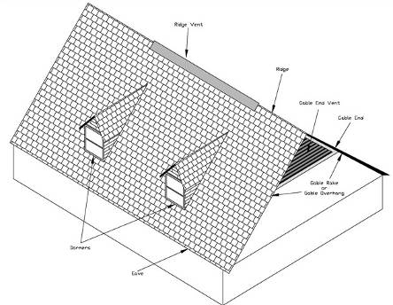
Treatments focus on exterior entry points

Slide 9
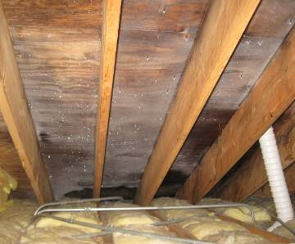
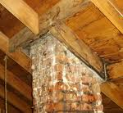
Interior services are limited to the attic

Slide 10
On Commercial buildings same idea, just on a bigger scale

Slide 11
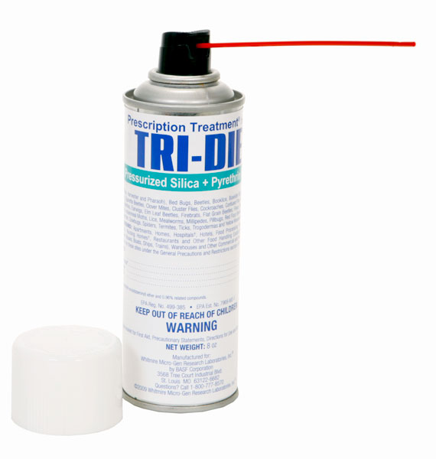
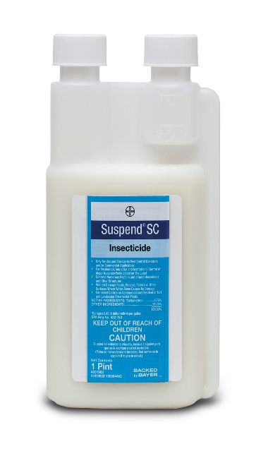
What are we treating with?
Liquid Pyrethroids
Lambdacyhalothrin (Demand)
Deltamethrin (suspend)
Indoxacarb (Arilon)
Carparyl dust (apicide)
Silica gel, pyrethrins, PPB (Tri-die)
Pyrethrin, PPB, dicarboximide (residual fogger)

Slide 12
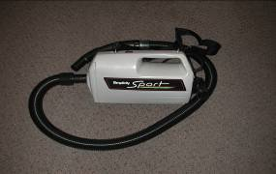
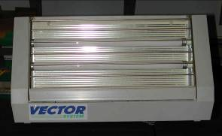
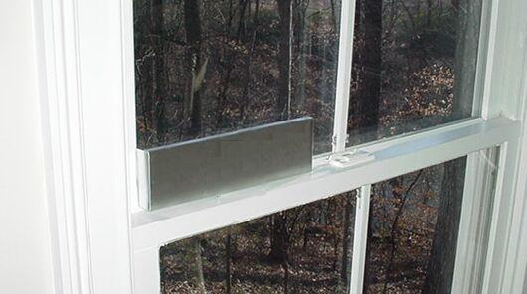
What can we do after the bugs get in?

Slide 13
2010 – 2011 survey results
14%
5%
12%
81% Pleased With Results
Wow
69%
Good
Poor
Fail
Contacted 220 Clients 123 responded to the survey = 56% response rate

Slide 14
2014 service calls
August 15th to September 30th – 315 jobs
September 1st to May 30th – 11 service calls on 9 locations (2 locations had 2 service calls)
3% callback rate

Slide 16
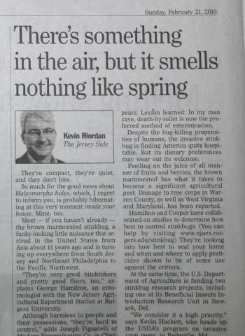
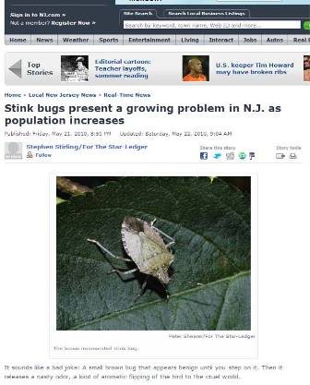
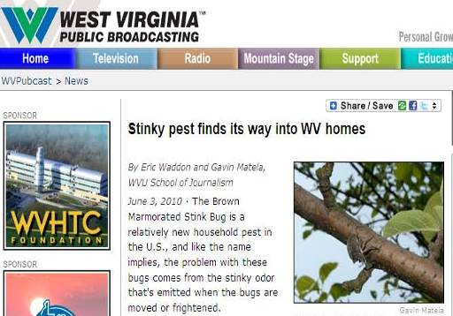
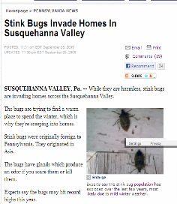
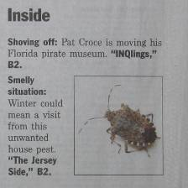

Slide 17
Today…. Not too much
And the not much is in States where the BMSB has recently spread to.
Is our low callback rate caused by better service or less pressure?
2012 72 new clients
2013 19 new clients
2014 37 new clients

Slide 18
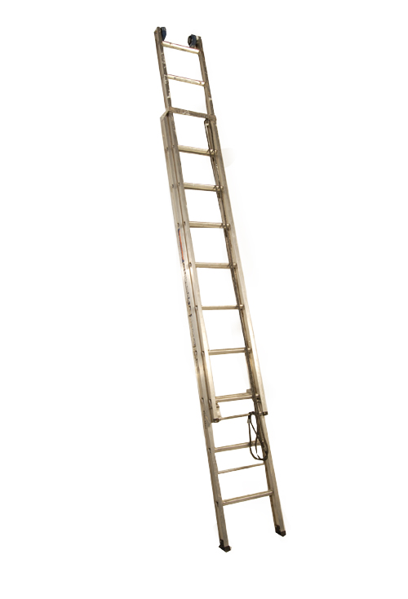
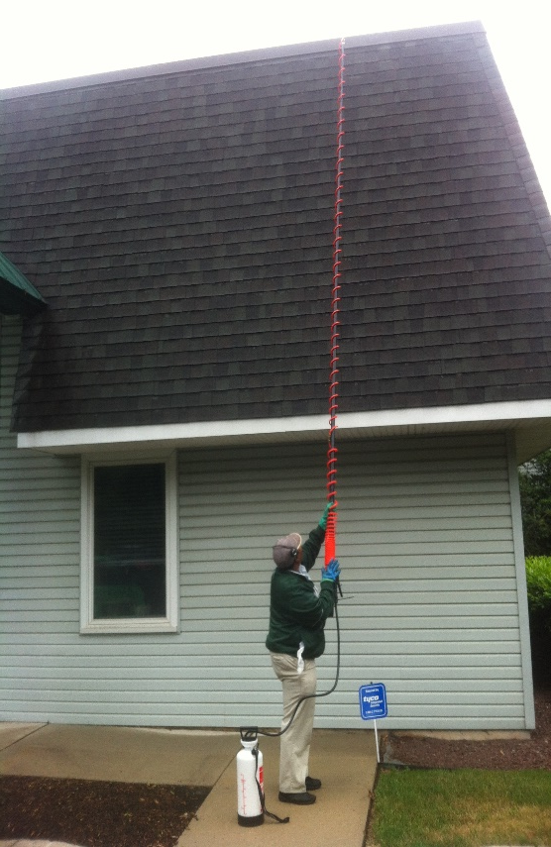
Timing issue = labor issue
We have 45 days at most to get the work done
August 15th – September 30th
Going up and down ladders is tiring.
Ladders + Tired = Injuries

Slide 19
Pyrethroid label changes
All outdoor applications must be limited to spot or crack & crevice treatments only except for the following permitted uses
1. Treatment of soil of vegetation around the structure
2. Applications to lawn turf and other vegetation
3. Applications to building foundations, up to 3’

Slide 20
The U.S. Environmental Protection approved revisions to pyrethroid labels that permit PMPs to make outdoor applications beyond applications to cracks and crevices and spot treatments, provided the application is made through the use of a coarse, low pressure spray over a treatable surface (bare soil, lawn, turf, mulch or other vegetation) and not an impervious surface like a driveway or sidewalk

Slide 22
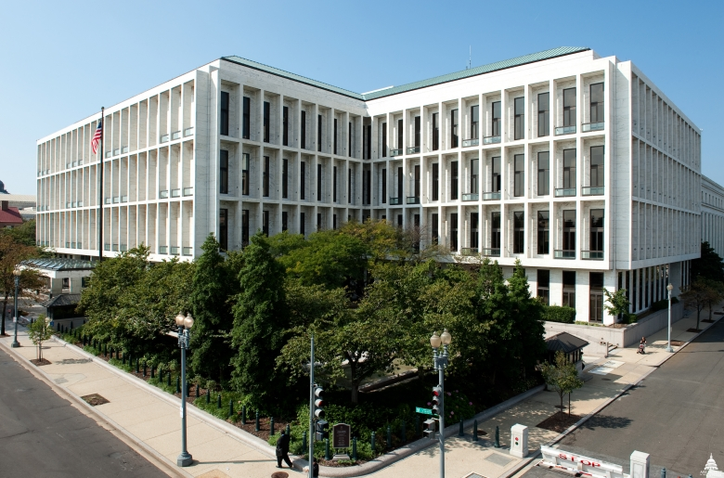

Slide 23
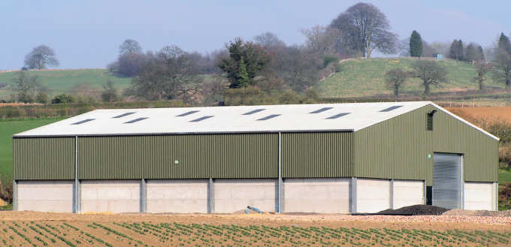
Parting thought

Slide 24
Questions?
Dave Burgess
Cooper Pest Solutions
1-800-949-2667
Dave.Burgess@cooperpest.com
Special thanks to Richard Cooper

