Slide 1
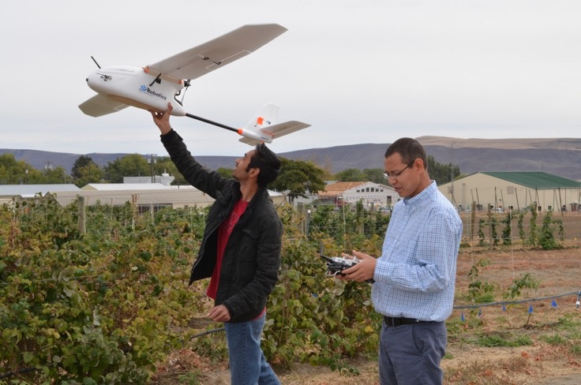
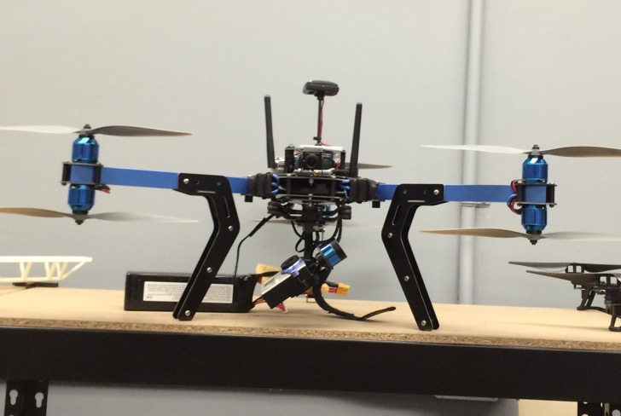
UASs for Pest management:
Opportunities and challenges
Manoj Karkee
Contributors: L. Khot, J. Leachman, S. Sankaran, M. Taylor, Q. Zhang
Center for Precision and Automated Agricultural Systems
Biological Systems Engineering Department
Washington State University

Slide 2
A little bit about CPAAS

Slide 3
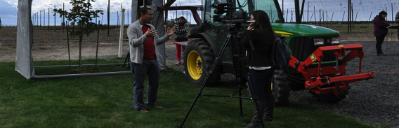
CPAAS: Center for Precision and Automated Agricultural Systems
  Located in Prosser, WA; Directed by Dr. Qin Zhang
  15+ affiliated faculty members
  Cross-disciplinary environment: extension educators, horticulturists, biologists, economists and engineers
  Facilitates collaborative, systematic research in precision agriculture, automation and mechanization

Slide 4
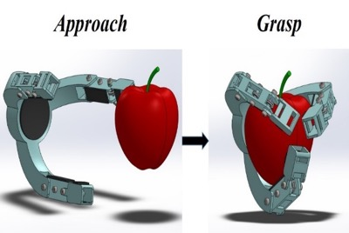
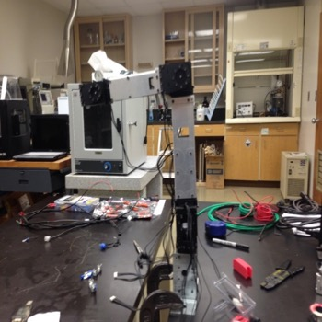
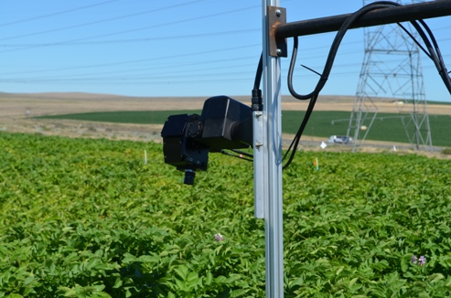
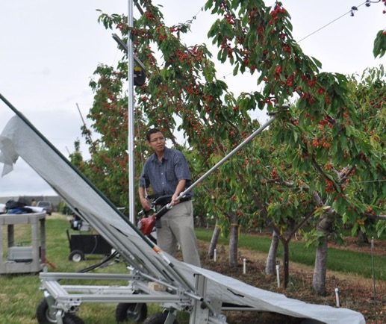
Major Research Areas/projects
Apple and Cherry Harvesting
Apple and Raspberry Pruning
Intelligent Bin Transport System
Automated Weed Control In Vegetables
Water and Nitrogen Stress Sensing
Solid Set Canopy Delivery System
UASs for Production Agriculture

Slide 5
Unmanned Aerial systems

Slide 6

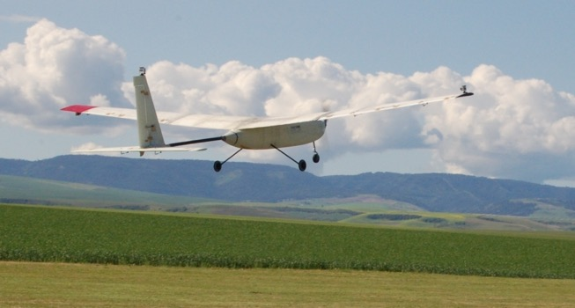
UAS…..
Unmanned Aerial Systems
Also called UAVs (Unmanned Aerial Vehicles) and Drones
Hardware Platform: Fixed Wing and Multi-copters
Communication and Navigation
Ground Control/Operator, Auto-guidance, Auto-pilot
Payload: Sensors, Tanks, Chemicals, Sound and Light Emitters
Sensors (e.g. Cameras, Lasers, Multi-spectral Sensors)
Data Collection, Processing, Storage, Distribution

Slide 7

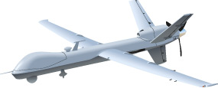



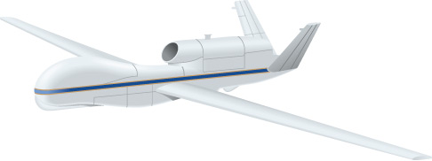

Size/SCALE of UAVs
Source: WSU Magazine

Slide 8
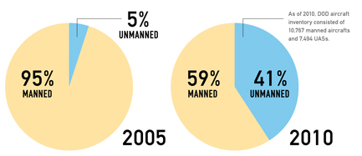
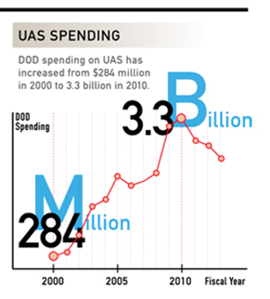
UAS Economic Impact
DOD Spending
http://www.auvsi.org/resources/economicreport

Slide 9
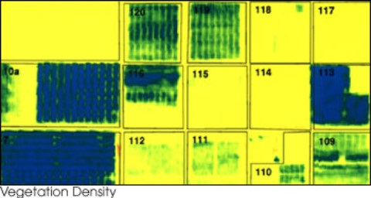
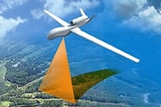
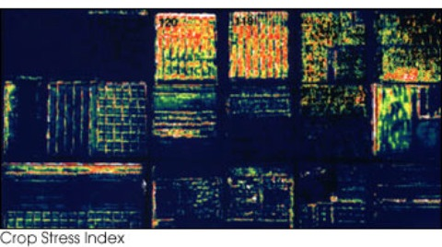
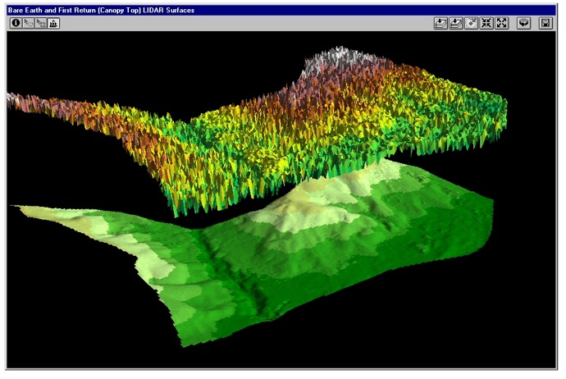
IT is a Prime Time for Agriculture
AUVSI -“Precision Agriculture will lead civil UAS.” March 2013
CA, WA and TX leading the UAS industry growth
Plant-by-Plant resolution from UASs.
Images from web!

Slide 10
UASs For pest management

Slide 11
Application areas
General interest in smaller to mid-size, low cost platforms
Applications can be categorized to
  Passive Applications
    Remote Sensing
    Crop Monitoring
    Pest Management Aid
  Active Applications
    Precision Chemical Application
    Bird Deterrence

Slide 12

Ongoing Engineering Efforts
Validating Applications with Proven Values
  Color and NDVI maps
  Plant Stress Maps
  Precision Chemical Application
New/Emerging Applications
  Identifying New/particular Diseases
  Bird Deterrence
Technological Development
  Increasing stability and endurance of low cost platforms
    Battery swapping, fuel cell
  Improved image stitching; new data mining techniques

Slide 13

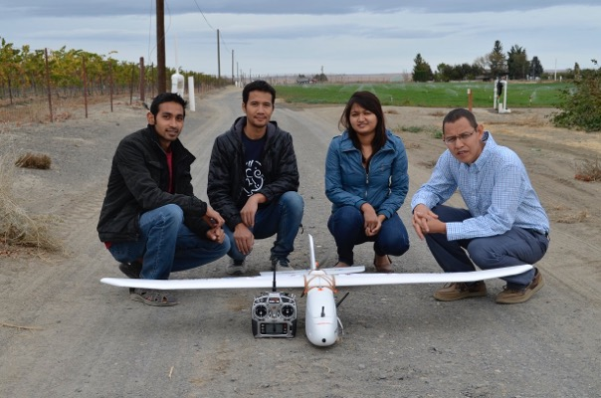
Remote sensing with UAS
Remote Sensing Platforms
  Fixed Platforms
  Ground Vehicles
  Satellites
  Aerial – Manned and Unmanned
UAS has Potential for
  Higher Resolution Data
  More Frequent Flights
  Safer Operation
  Flexibility and Maneuverability
  Lower Cost

Slide 14
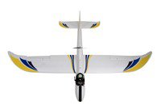
Monitoring for Pest management
Mapping plant/canopy variability and stress
Monitoring effectiveness of pest control strategies
Real-time monitoring for field management

Slide 15
Examples

Slide 16
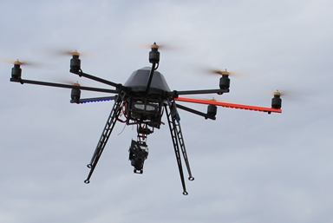

Detecting Vine Vigor
Khot, Sankaran; WSU

Slide 17
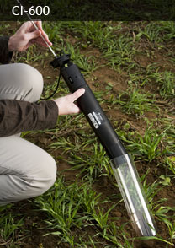

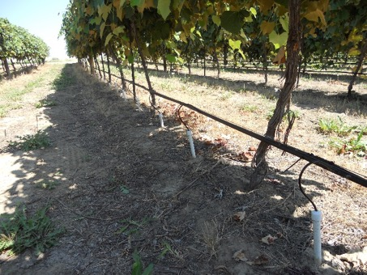

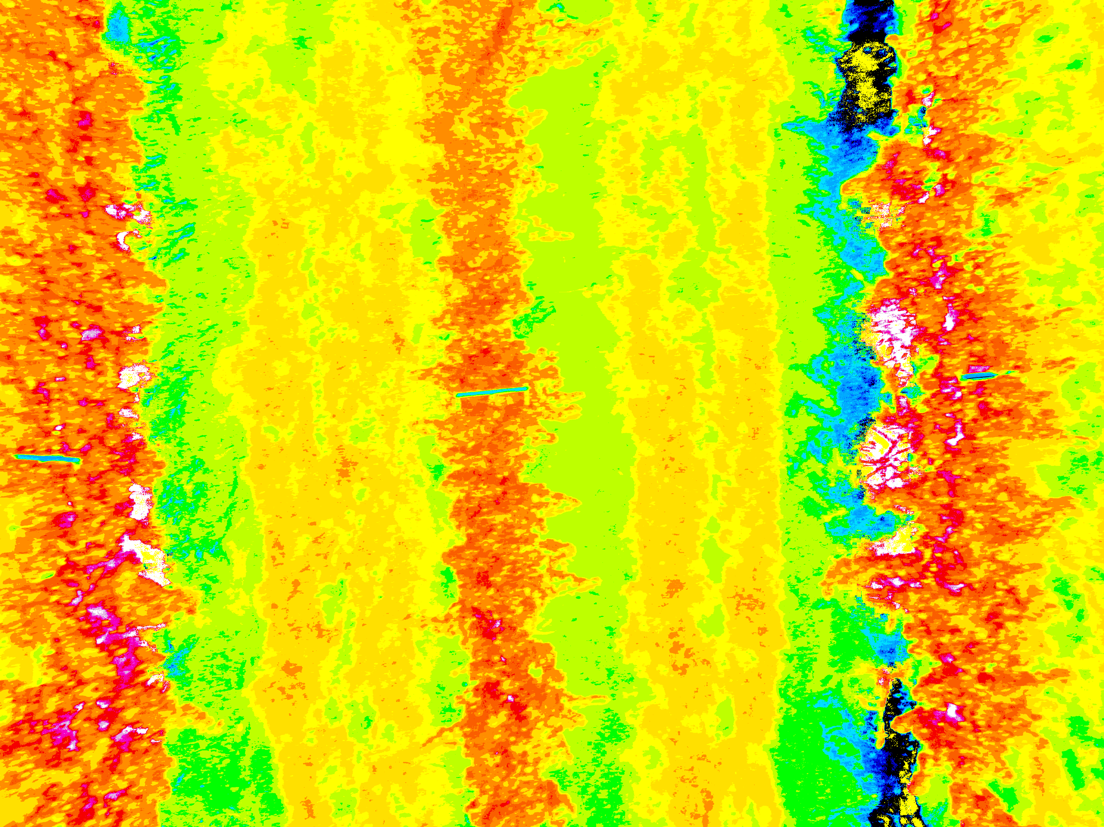
Monitoring Sub-surface Micro-irrigation (SSMI)
Jacoby, Sankaran, Peters, Keller et al.; WSU
Precision SSMI to regulate wine grape physiology
Comparison of SSMI to standard surface drip application
Sub-surface micro-irrigation
Mini-rhizotron camera- root monitoring

Slide 18
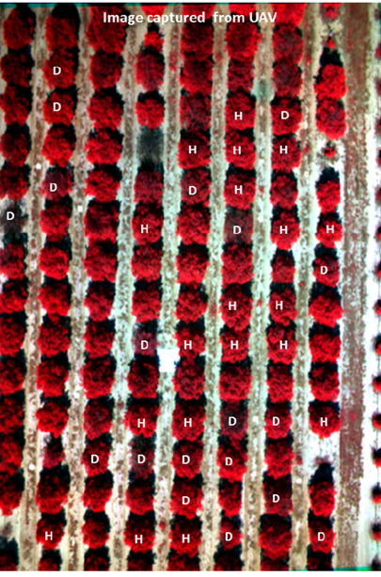
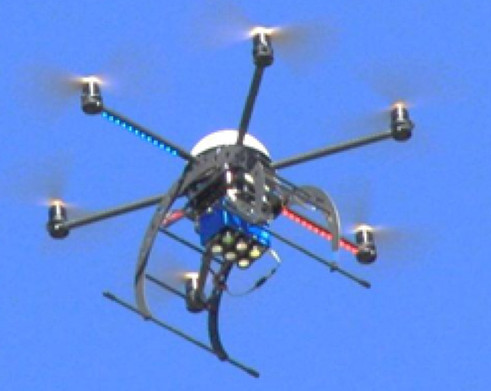
HLB (Citrus Greening) disease detection
Garcia-Ruiz, Ehsani, et al., University of Florida

Slide 19
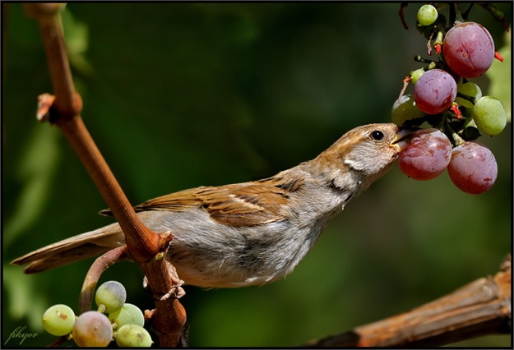
Birds: A big problem for Ag
2013 Survey of 252 farmers in Washington State
Bird damage in WA estimated at $80 million!
Grower collaborators indicated 50% crop loss to migratory birds in 2010

Slide 20
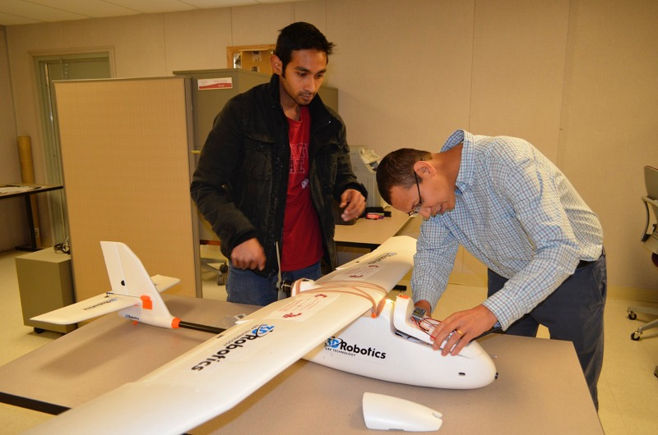
UAV for Bird deterrence
    Karkee, Leachman, Taylor, Zhang
  Preliminary studies by OSU collaborators
    No conclusive results
  More work going on at WSU
    A fixed wing and a hex-copter
  3D Robotics Aero-M; Fixed Wing UAS

Slide 21
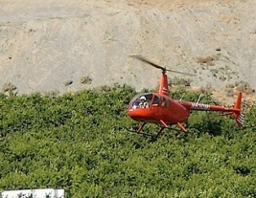

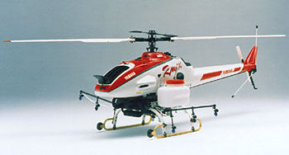




Preventing Cherry Cracking due to Rainwater
Khot, Zhang et al.

Slide 22
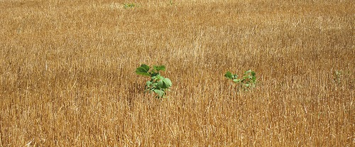
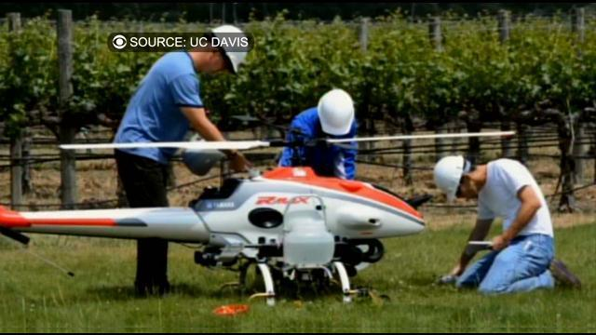
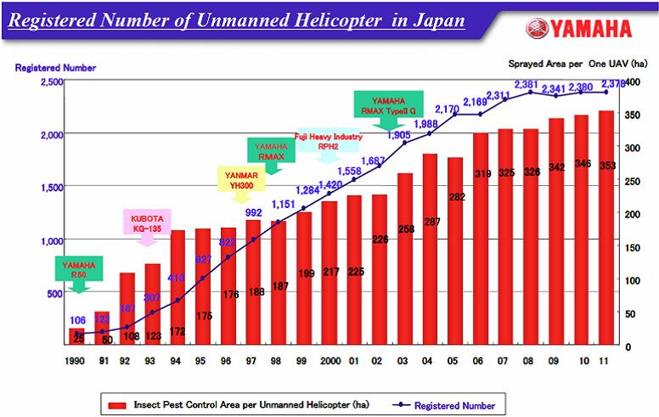
Autonomous/Precision spraying
Substantial acreage sprayed by UAS in Japan.
Similar application in trial in CA Vineyards; UC Davis

Slide 23
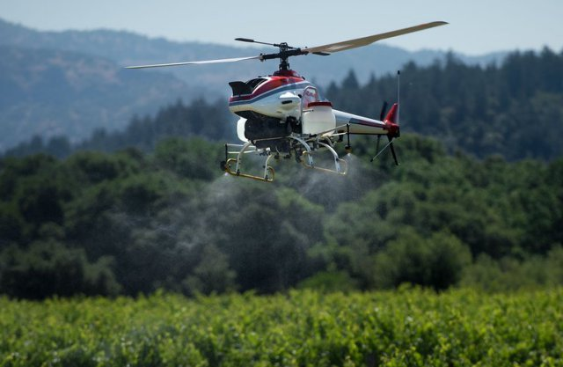
Autonomous spraying in Napa Valley
Image Source: http://www.uasvision.com/

Slide 24
Technology development
  Platform stability, weight, speed
  Multiple vehicles
    Coordination/Collaboration
    Feet size optimization
  Charging Station
    Automatic battery swapping
  New Power Sources
    Hydrogen Fuel Cell
  New Sensors for Ag
    Light weight, target specific

Slide 25
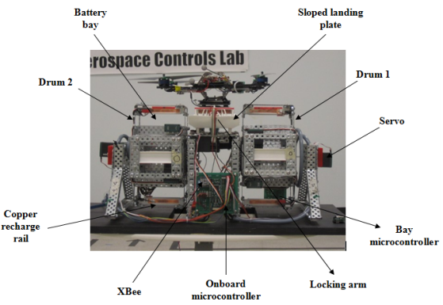
Battery swapping
  Charging station for multi-copter
  Automated battery swapping
  Not trivial for fixed wing platforms
Toksoz et al., 2011

Slide 26

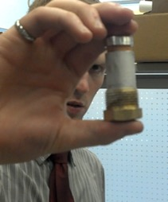

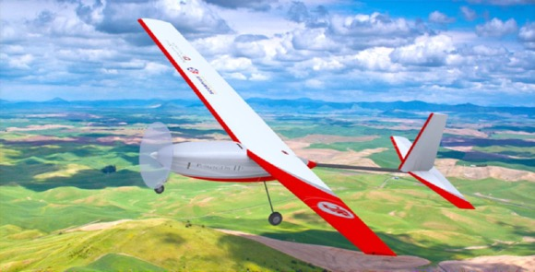
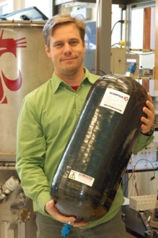
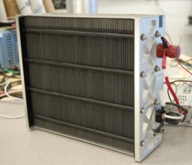
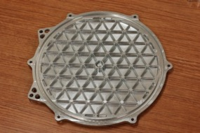
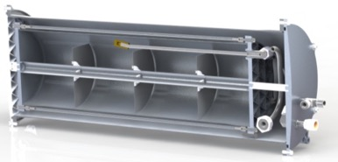
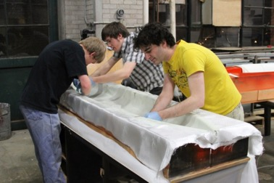
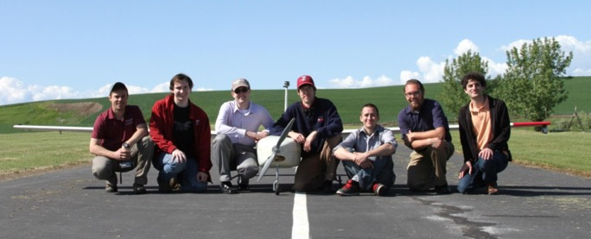
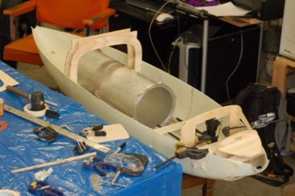
Liquid Hydrogen Fueled UAS
Work of Jacob Leachman, WSU

Slide 27
Challenges and future direction

Slide 28
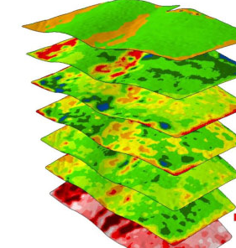
Data Vs Information
  How to convert data into actionable knowledge?
    Big data, data mining
  How to go beyond the differences in spectral signature?
    Identifying nature of stress and do something about it
BramleyI & Trengove, 2013

Slide 29
Internet of things
  Connectivity and Integration
    Satellite sensors
    Manned flights-based sensors
    Ground sensors
      Yield monitors
      Weather stations
    Ground vehicles
      Precision chemical applicators
    Models/Decision support systems
      Crop models, Weather models

Slide 30
Innovative Applications/approaches
  Need to think outside the box
    Exploit handy, low cost flying platforms
    e.g. Precision pollination
Multi-purpose platforms/flights
  Collect data while chasing birds
  Economic analysis
Trans-disciplinary approaches including
  Biological, physical and social scientists

Slide 31
Platform, Payload and Data Processing
  Platform stability/robustness
  Autonomy
    Minimize human involvement
  Endurance still the biggest challenge
  Payload
    Increase payload capability
    Lighter and stable sensors
  Sensors with agricultural applications in mind
  Calibration and registration
  Image quality, image mosaicking

Slide 32
Potential Adoption models
In-house Technology
  Semi-autonomous
    Acquire hardware
    Fly as needed; upload data
    Contract data management and processing service
  Autonomous
    Acquire hardware, software and storage (local or cloud)
    Dedicated in-house operator(s)
    Contract maintenance and consultancy service
Service Companies
  On-demand imaging and data processing
  Per-acre cost

Slide 33
FAA and Flight Authorization
  Certification of Authorization (COA) for each research task
    May take a few months
    Comprehensive process
    Description of what, where and why
    Ground school competency for operator(s)
      Third class airman medical certificate
    Visual observer
    Comprehensive reporting
    Limited experiments may be possible with tethering
FAA – Federal Aviation Administration
COA – Certification of Authorization

Slide 34
New regulatory Developments
  Creation of Six Test Centers (e.g. AK, ND)
  Recent exemption to commercial entities
    Empire Unmanned, Idaho
    Amazon Delivery Trials
  Proposed regulation for Small UAS
    Small UAS: <55 lb
    Operator >17 years; Optional visual observer
    Line of sight; day time; Out of airport flight paths
    <500 ft above ground level; <100 mph
    No airworthiness certificate
  Option to COA or comply with new regulations without COA

Slide 35
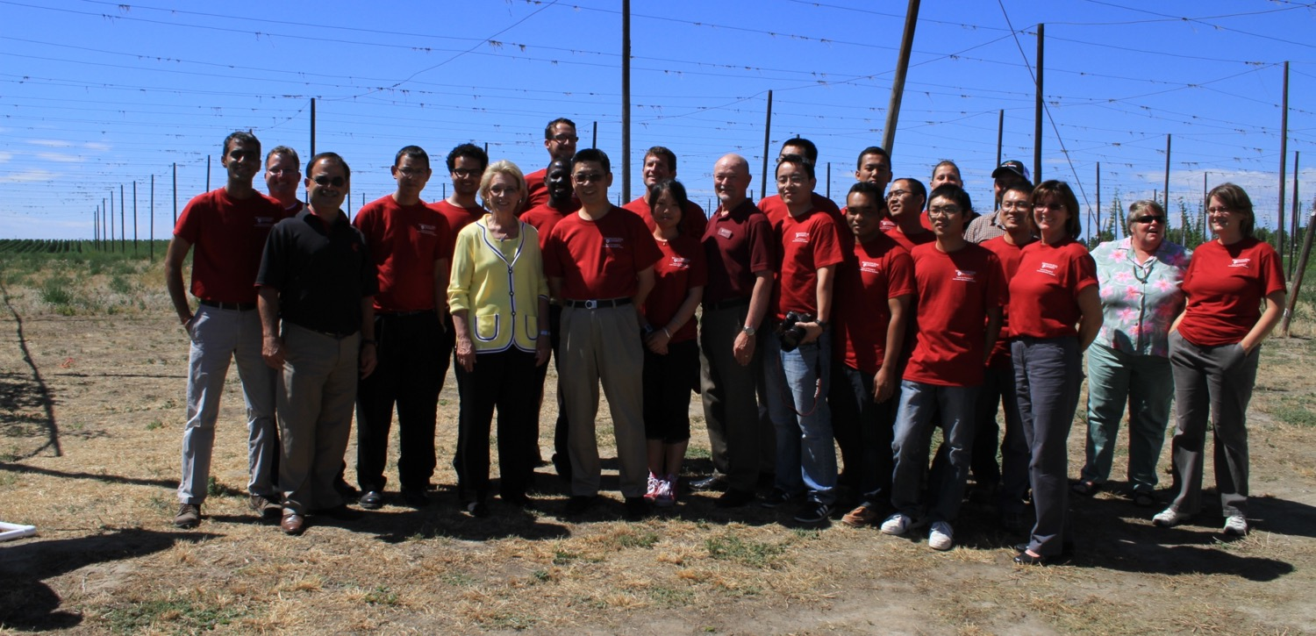
Thank You

