Slide 1
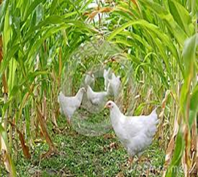
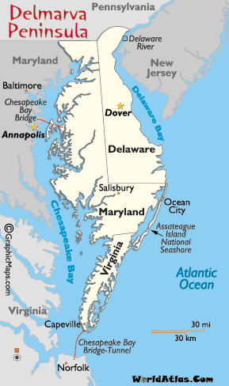
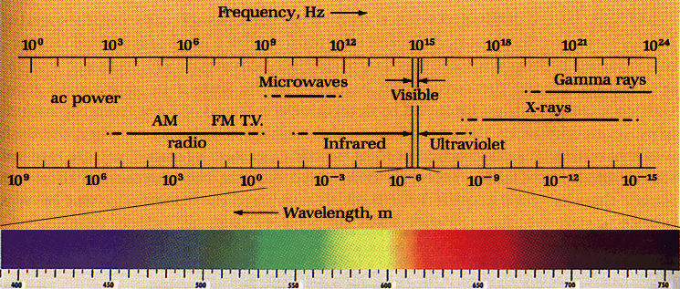
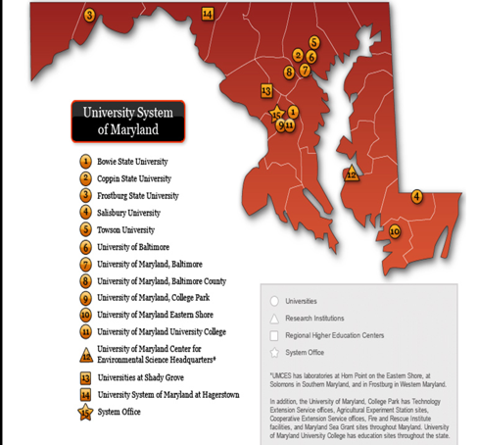
AIRSPACES : Aerial Imaging and Remote Sensing for Precision Agriculture and Environmental Stewardship
Abhijit Nagchaudhuri, Ph.D., Professor(Engineering)
Dept. of Engineering and Aviation Sciences
University of Maryland Eastern Shore
UMES Collaborators : Dr. Madhumi Mitra , Dr. Lurline Marsh
and Dr. Jurgen Schwarz ( School of Agriculture and Natural Sciences), Christopher Hartman ( Aviation Coordinator)
External Collaborators : USDA, NASA, Pioneer Hi-Bred Int.
Support : UMES STEAM students , GIS Pgm Mgr, and farm personnel
8th International IPM Symposium | MARCH 23–26, 2015 | SALT LAKE CITY, UTAH

Slide 2
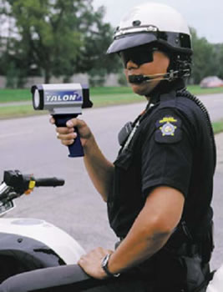
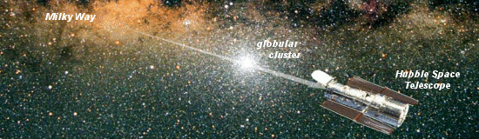
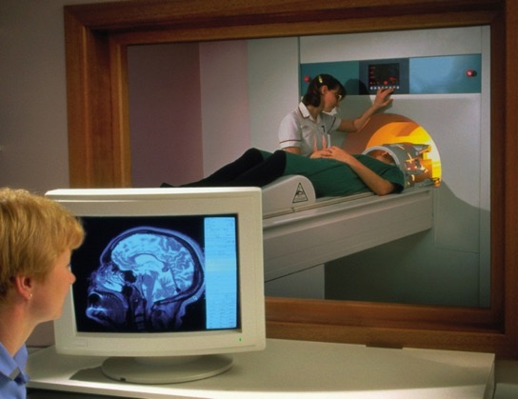
REMOTE SENSING
Remote Sensing is a broad field encompassing approaches to extract information about objects without coming into physical contact with them.
Remote sensing is broadly classified as passive, where the sensing system acquires information from the solar reflectance or electromagnetic emission from objects (e.g., ETM) and active, where the sensing system provides its own source of directed radiation and captures reflectance or backscattering of the radiation from the target objects (e.g., RADAR).
http://www.laserveil.com
/radar/jammers/
Credit : Hubble ( Space Telescope Science Institute)
http://www.aokc.net/latest-news
8th International IPM Symposium | MARCH 23–26, 2015 | SALT LAKE CITY, UTAH

Slide 3
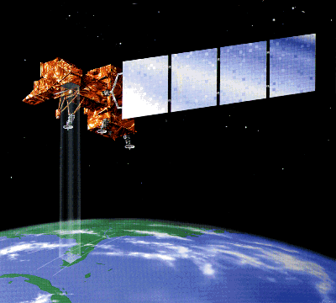
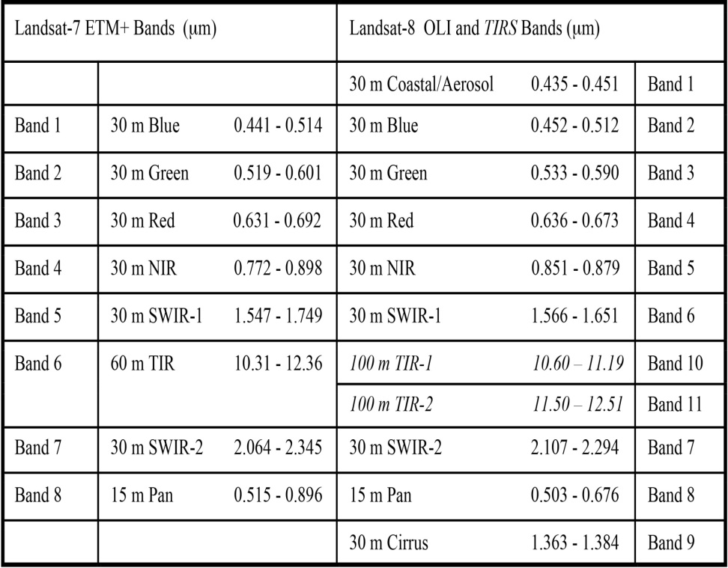
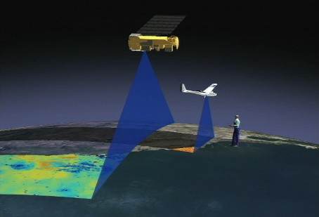
REMOTE SENSING
Remote sensing is widely utilized by scientists and engineers in space and earth sciences, medical sciences, agriculture, various applications in the industry, and social sciences.
https://geo.arc.nasa.gov/sge/landsat/l7image.html
http://landsat.gsfc.nasa.gov/?p=3186

Slide 4
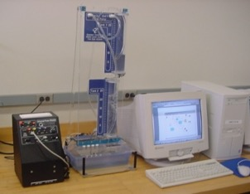
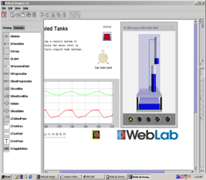
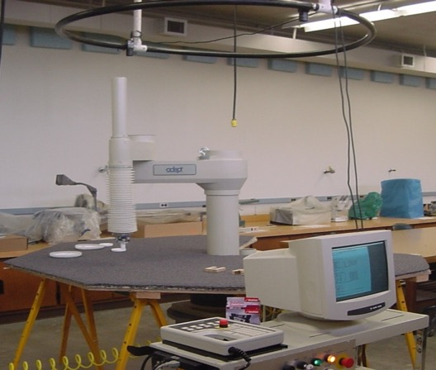
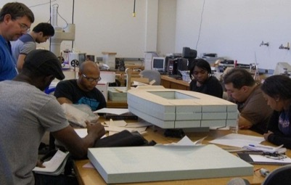
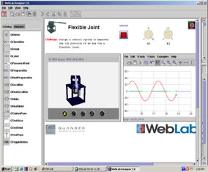
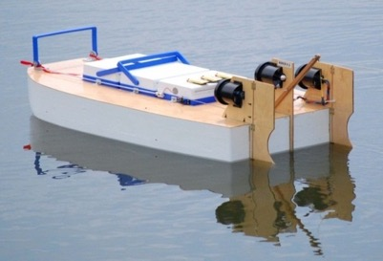
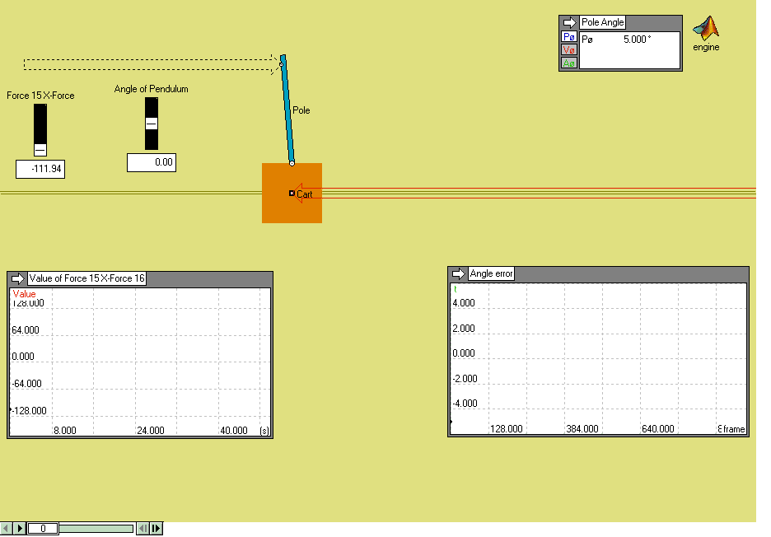
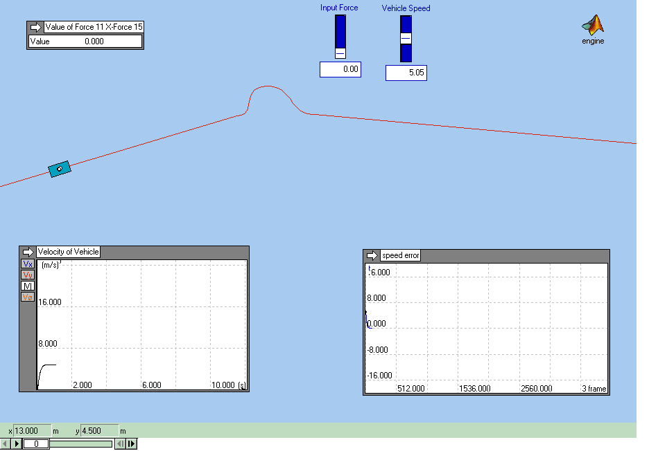
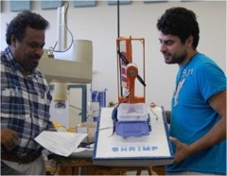
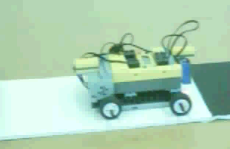
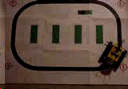
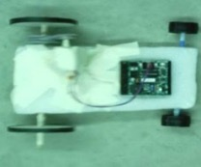
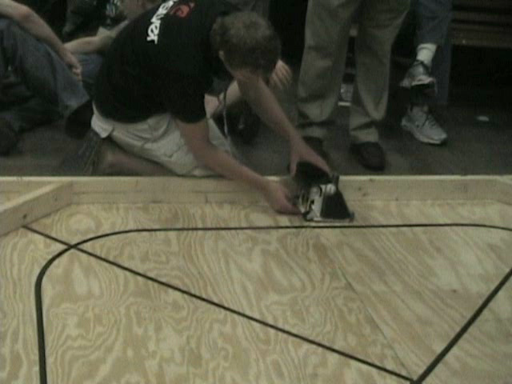

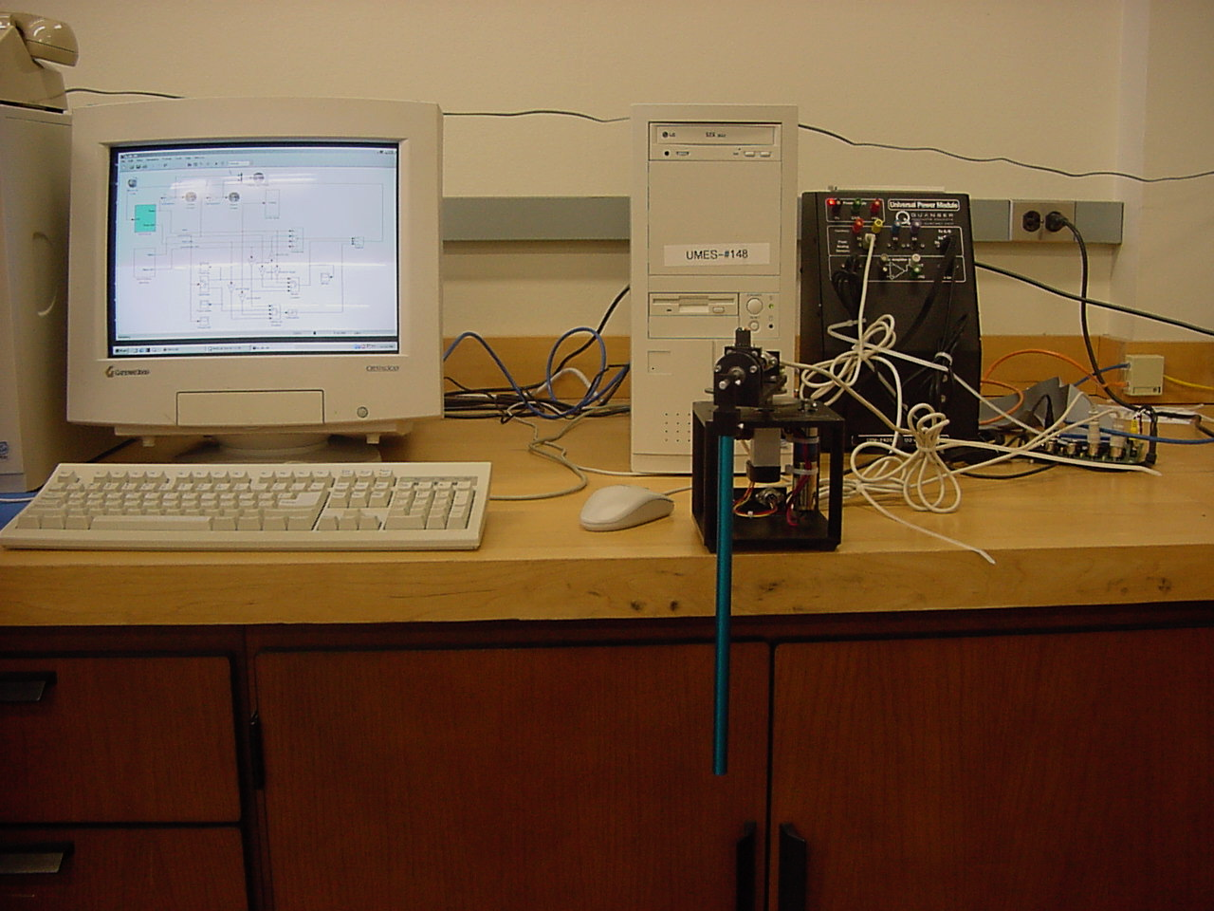
Robotics and Mechatronics Laboratory(UMES)
Nagchaudhuri, A., Kuruganty, S., and Shakur, A., “Introduction to Mechatronics Concepts in a Robotics Course using an Industrial SCARA Robot and Integrated Vision System”, Mechatronics ( Elsevier Science Ltd.)Vol. 12, 2002, pp. 183-193.
8th International IPM Symposium | MARCH 23–26, 2015 | SALT LAKE CITY, UTAH

Slide 5
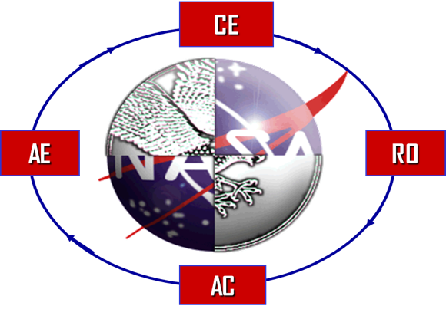
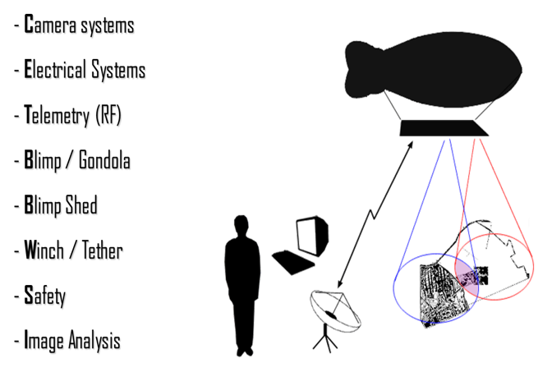
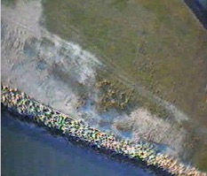
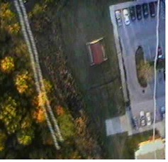
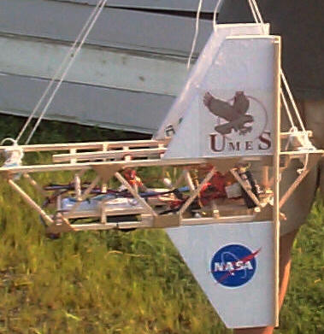
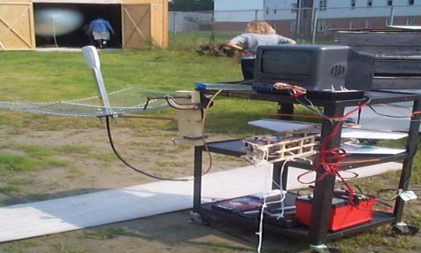
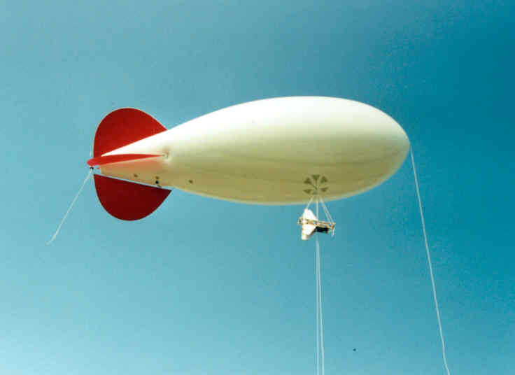
REMOTE SENSING AT UMES - INITIAL PHASE
UMESAIR :Undergraduate Multidisciplinary Earth Science
Airborne Instrumentation Research
- Blimp
7 foot dia.
21 foot length
16 lb. lift
Gondola-7 lb.(max) (includes all components) Detachable from blimp
2.4 GHz transmitters,
4-Channel simultaneous
( Upto 2500 ft.)
Nagchaudhuri, A., and Bland, G., 2002. "UMES-AIR: A NASA-UMES Collaborative Project to Promote Experiential Learning & Research in Multidisciplinary Teams for SMET Students", Journal of SMET Education: Innovations and Research. Jul –Dec

Slide 6
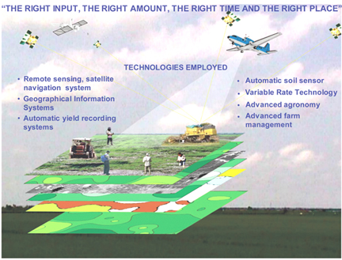
What is precision agriculture?
Environmentally Conscious Precision Agriculture – A Platform for Active Learning and Community Engagement
Precision Agriculture involves optimizing inputs and monitoring outputs of an agricultural system at as high a spatial resolution as possible to improve profits and minimize environmental impact.
Also called
  Site Specific
  Management (SSM)
  Precision Farming (PF)
  Precision Crop
  Management (PCM)
Simple definition
  Right Input
  Right product
  Right time
  Right place
http://blog.farmorganix.com/wpcontent/uploads/2013/01/Precision_Farming.jpg

Slide 7
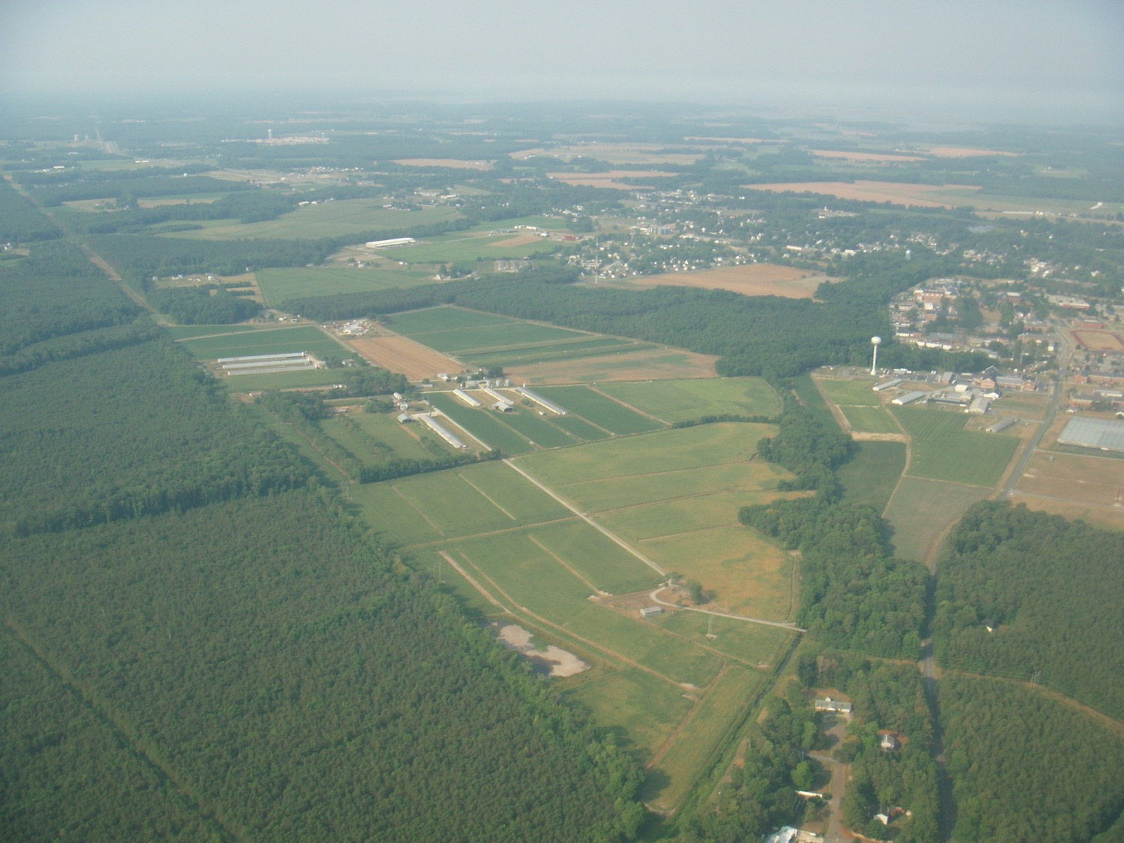
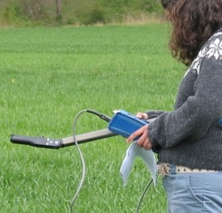
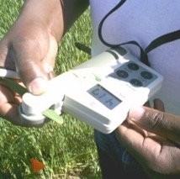
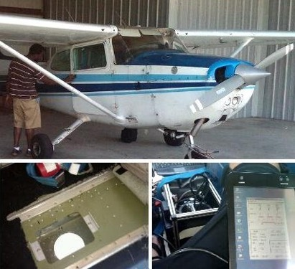
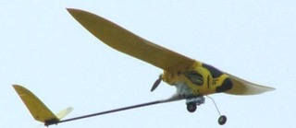

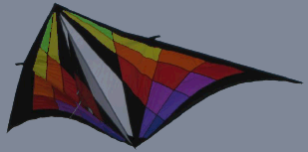
UMES ECPA/ AIRSPACES Projects - Pictorial Overview (2006-2011)
Various Aspects of Field Experiments ( General Overview)
Ground Based Data
Leaf Area Index LAI2000
Average height
NDVI/ Greenseeker Chlorophyll contentSPAD502
Remotely Sensed Data
Terra Hawk aerial imaging
Kite aerial imaging
R/C Models with Camera
Plant density count
Final harvest via Yield Monitoring
Henry, X., Nagchaudhuri, A., Mitra, M., and Marsh, L., 2013. “Using Variable Rate Seeding and Remote Sensing Technologies to Optimize Corn Yield and Profit on a Farm with Non-Uniform Productivity”, International Journal of Applied Agricultural Research, Vol. 8, No:2, 2013, pp. 187-200.
8th International IPM Symposium | MARCH 23–26, 2015 | SALT LAKE CITY, UTAH

Slide 8

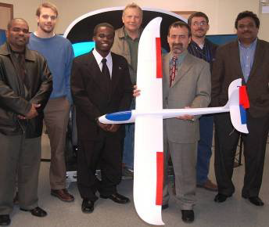
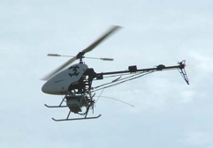
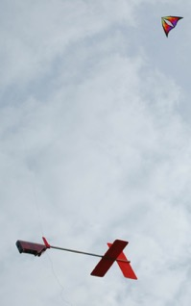
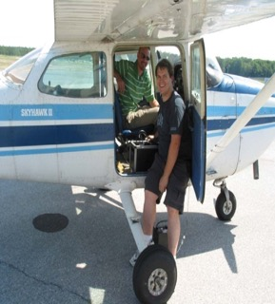
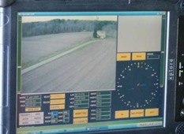
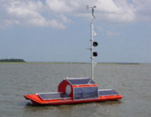
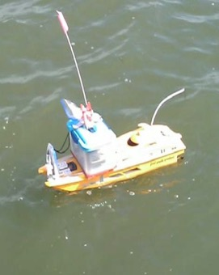


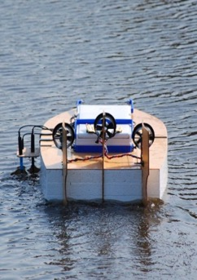
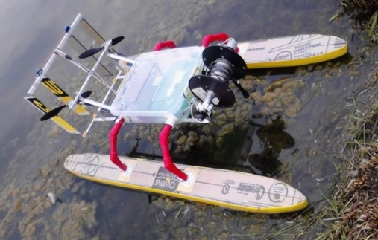
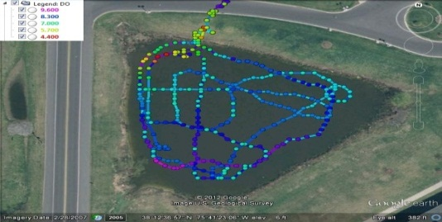
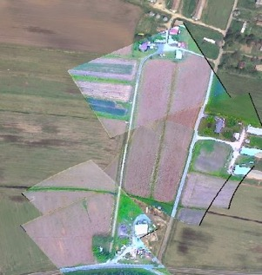
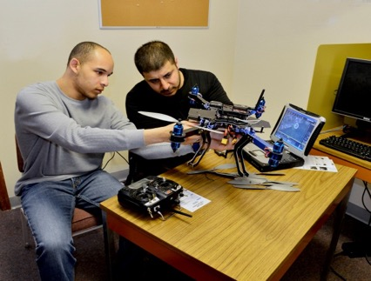
AIRSPACES²
Aerial Imaging and Remote Sensing for Precision Agriculture and Environmental Stewardship
Air-propelled Instrumented Robotic Sensory Platform for Assateague Coastline Environmental Studies

Slide 9






RC-UAVS-GEOREFERENCING and MOSAICKING ( Early Efforts)
Software tools : Multispec, ARCGIS,SMS, and MATLAB

Slide 10








Remote Sensing and Yield Map ( Early Efforts)
(http://pubs.ext.vt.edu/442/442-502/L_44250201.jpg)
Bozman
Aerial images do not have enough resolution to capture the low levels of yield variation observed from the yield monitor data
Example: Unable to see vertical line of poor yielding area
Bozman -Corn

Slide 11

Overview

Slide 12




EMPHASIS ON DEFENSE
(PEOPLE – PLANET- PROFIT)
Precision Agriculture : Turning Swords into Ploughshare
Precision Agriculture : Turning Swords into Ploughshare
D D - Disease Prevention
E - Energy
F - Food
E - Environment
NS - National Security
E - Education
- Disease Prevention
E - Energy
F - Food
E - Environment
NS - National Security
E - Education
D - Disease Prevention
E - Energy
F - Food
E - Environment
NS - National Security
E - Education
The phrase “the triple bottom line” was first coined in 1994 by John Elkington, the founder of a British consultancy called SustainAbility.

Slide 13




MULTISPECTRAL REMOTE SENSING CAPABILITIES AT UMES : Cessna 172 (Manned)
,

Slide 14






MULTISPECTRAL REMOTE SENSING-CESSNA172- TERRAHAWK- UMES-FIELD EXPERIMENT (Manned
,

Slide 15


MULTISPECTRAL REMOTE SENSING CAPABILITIES AT UMES ( Tetracam)
KITES/UAVS
,
The ADC Lite contains a single 3.2 megapixel Complementary Metal Oxide Semiconductor (CMOS) sensor ( single array with Bayer pattern filters) optimized for capture of visible light wavelengths longer than 520 nm and near-infrared wavelengths up to 920 nm.
8th International IPM Symposium | MARCH 23–26, 2015 | SALT LAKE CITY, UTAH

Slide 16




MULTISPECTRAL REMOTE SENSING- KITE- UMES-FIELD EXPERIMENT
,

Slide 17



Applied Research Field Experiments utilizing Variable Rate Nitrogen Application, Remote and In Situ Sensing, and Drought Tolerant Corn Seeds (2012 -2015) ( NIFA : CBG)
http://www.engineeringchallenges.org/

Slide 18








Applied Research and Field Experiments utilizing Variable Rate Nitrogen Application, Remote and In Situ Sensing and Drought Tolerant Corn Seeds (2012-2015)

Slide 19









PMT, GRID SOIL SAMPLING – SOIL TEST RESULTS ON GIS MAP ( BOZMAN FIELD)
WICKED PROBLEM – EASTERN SHORE
Batie, 2008
PMT delays could outlast O’Malley administration
By BRUCE HOTCHKISS
Senior Editor
(July 1, 2014) Even as an ……

Slide 20








“Not so Remote Sensing” Optical sensors – Crop Health- (CIR) Color InfraRed Digital Camera
http://agribotix.com/
http://agrielectronics.blogspot.com/2013/
Individual OptRx Active Sensor
OptRx sensors are active sensors that can shine light centered on 670nm (red), 730nm (red_edge) and 780 nm (near-infrared) wavelengths and record reflectance from the crop canopy to determine VIs (vegetation indices) such as NDVI ($\frac{NIR−RED}{NIR+RED}$ ) and NDRE ($\frac{NIR−RED_EDGE}{NIR+RED_EDGE})$ indicative of crop biomass and nutrient stress.

Slide 21




VARIABLE RATE NITROGEN APPLICATION – FIELD TRIAL ( 2013)
Sensed NDRE (left) and Applied N maps (right) - Ag Leader SMS software

Slide 22

Applied Research and Field Experiments utilizing Variable Rate Nitrogen Application, Remote and In Situ Sensing and Drought Tolerant Corn Seeds(2012-2015)
6 Rows, 108 Plots
  15ft x 50ft, 26” bt. Rows
3 factors (6 levels of Nitrogen)
2 seed types
Odd: regular seed
Even: AquaMax
( Drought Tolerant)
3 irrigation levels (rainfed, fully irrigated, partial season irrigation)
FIELD EXPERIMENTS
Experimental ( 2 acre)
  Seed, Irrigation, Fertilizer
Rest of Bozman (40 ac)
  Mid, Early, Late planting
  Seed ( regular and Aquamax)
Presidential field (15 ac)
  Density(24k, 28k, 32k seeds/acre)
  Seed (regular and Aquamax)
Nagchaudhuri, A., et, al ( 2014) “Towards Greener Farms and Cleaner Bays in the Eastern Shore”, Paper number 141913243, Proceedings of 2014 ASABE, \

Slide 23










Applied Research and Field Experiments utilizing Variable Rate Nitrogen Application, Remote and In Situ Sensing and Drought Tolerant Corn Seeds(2013)
Measurements
Soil Nutrient
Content
  Growth Stage
  Height
  SPAD
  Reflectance
  Thermal Temperature
  Soil Moisture
  Yield

Slide 24


3DRobotics X8
FAA COA approved July 1, 2014
3DRobotics X8 with Tetracam ADC Lite
Series of test flights with first data acquisition on July 10

Slide 25

Mission Planner
Applied Research and Field Experiments utilizing Variable Rate Nitrogen Application, Remote and In Situ Sensing and Drought Tolerant Corn Seeds(2014)- UAV Remote Sensing (Mission Planner)
3DRX8 - Mission ( UAV Flight Movie)

Slide 26



Applied Research and Field Experiments utilizing Variable Rate Nitrogen Application, Remote and In Situ Sensing and Drought Tolerant Corn Seeds(2014)-
UAV Remote Sensing
8th International IPM Symposium | MARCH 23–26, 2015 | SALT LAKE CITY, UTAH

Slide 27

Applied Research and Field Experiments utilizing Variable Rate Nitrogen Application, Remote and In Situ Sensing and Drought Tolerant Corn Seeds(2014)- UAV Remote Sensing
Hartman, C., Nagchaudhuri,A., Mitra,M., and Daughtry,C.,(2014)"The development of Nitrogen response curves for the improvement of Nitrogen use efficiency (NUE) on Maryland’s Eastern Shore " Paper number 141900381, Proceedings of 2014 ASABE \
8th International IPM Symposium | MARCH 23–26, 2015 | SALT LAKE CITY, UTAH

Slide 28



Acknowledgements
NIFA-USDA Capacity Building Grant
Maryland Space Grant Consortium /NASA
Dr. John Moisan,Geoff Bland ,and Ted Miles of NASA
Dr. Craig Daughtry of USDA Beltsville
UMES Students and Farm Personnel

Slide 29



Questions/Comments/Suggestions
8th International IPM Symposium | MARCH 23–26, 2015 | SALT LAKE CITY, UTAH

