Slide 1
School IPM
Rachel Maccini, Pesticide Education Coordinator
and
Faye Cragin, Web & Media Specialist

Slide 2
What is IPM?
It is an environmentally sensitive three prong approach that helps to manage pest problems:
Pest Identification and Monitoring
Prevention
Combinations of low-risk actions when needed
Evaluate effectiveness

Slide 3
What Does IPM do for Schools?
Provides:
Health Benefits
Economic Benefits

Slide 4
Health Benefits:
Prevents/minimizes environmental risks
Reduces risks of human exposure to pests and pesticides
Suppresses pests that may carry allergens or disease pathogens

Slide 5
Economic Benefits:
Reduces pest damage
Eliminates unnecessary pesticide applications
Minimizes emergency repairs
Fits well with regular maintenance and sanitation routines

Slide 6
Why Implement IPM?
Improves indoor air quality
Eliminates unnecessary pesticide use
Reduces human health risks
Improves property management
Saves money
Prevents pest related emergencies

Slide 7
Steps to Implement IPM in Schools
Establish an IPM Policy
Designate Pest Management roles- training
Annually inspect – establish a regular pest monitoring program
Use sanitation and exclusion tactics
Evaluate program effectiveness and keep records

Slide 8
IPM Policies for School Boards and Administration
Write an IPM policy statement
Emphasize the importance of IPM
Reasons for adopting IPM
Objectives of the program
Include guidelines for pest management issues and decision-making

Slide 9
Train and Educate
Who?
Staff (custodial, cafeteria, athletic, maintenance and grounds, health), students, pest managers, parents and the public
About?
potential school pest problems
IPM policies and procedures
roles for achieving set goals

Slide 10
What is a Pest?
An unwanted organism (animal, plant, bacteria, fungus,
virus, etc.) that has
a negative effect on
humans.

Slide 11
Most Pests are integral parts of the Earth’s ecosystem, but too many can:
Reduce the availability, quality, or value of human resources such as food, feed, water, or space.
Injure humans, animals, crops, structures, and possessions
Spread or cause disease
Interfere with our activities by causing annoyance, discomfort, or inconvenience

Slide 12
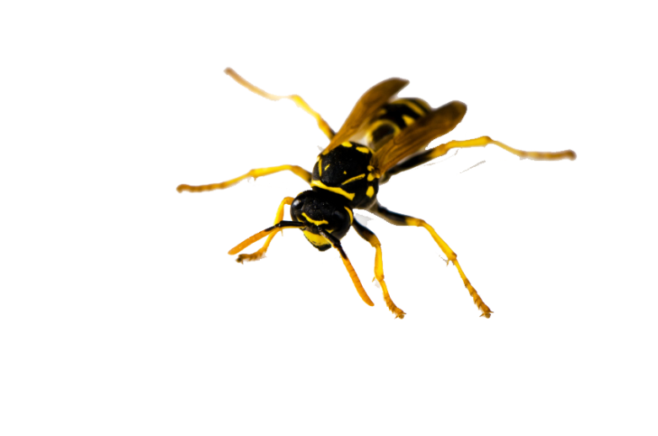
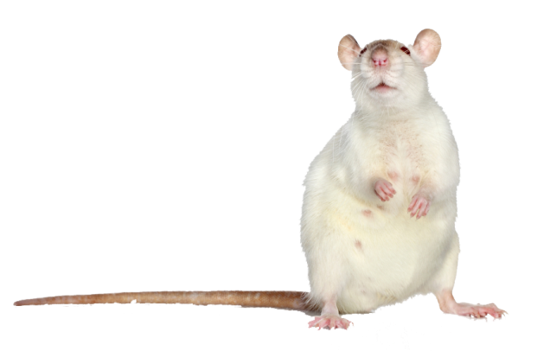
Pests most commonly found in or around schools
Insects:
Ants, cockroaches, flies, stinging insects (yellow jackets), pantry pests, lice, turf pests ( white grubs and Hairy Chinch bugs), mosquitoes
Rodents:
Mice, rats, bats, moles
Weeds:
Dandelions, Poison Ivy,
Annual grassy weeds, clover, etc.

Slide 13
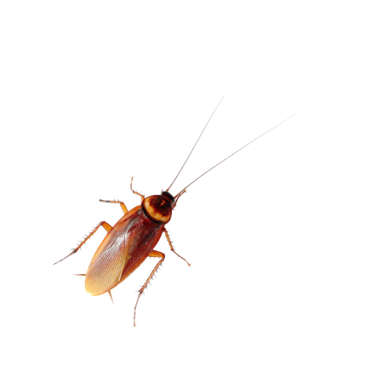
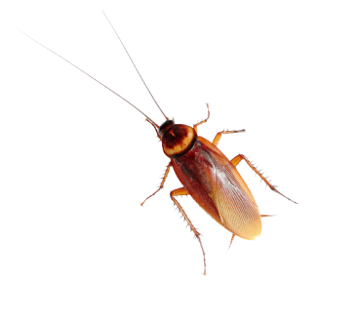
Possible Health Risks to Humans
Cockroaches and Rodents-asthma
Stinging Insects- Life-threatening allergic reactions
Lice- rashes
Rodents- salmonella, hanta virus, plague and more
Mosquitoes- West Nile Virus, encephalitis
Ticks- Lyme disease

Slide 14
Integrated Pest Management vs Pest Control

Slide 15
4 Steps of IPM
Inspection, monitoring & pest identification
Prevention
Intervention activities
Evaluation of effectiveness

Slide 16
Inspection, Monitoring & Pest Identification
*Inspections are critical for management of pests
Pest identification
Determining potential location of pest entry
Looking for pest signs (rodent droppings, feeding damage etc.)
Inspections should locate active infestations and signs of activity.
Inspections should identify pest sites and sources of food and water.

Slide 17
Pest Monitoring
Inspect sites and identify pest populations for potential problems regularly.
Helps determine if treatment is needed
Helps determine where, when and what kind of treatments are needed
Allows evaluation and fine tuning of treatments

Slide 18
Identifying Pests
The first step in solving a pest problem effectively and safely is correct identification of the pest.
New Hampshire:
UNHCE: extension.unh.edu
Vermont:
UVM: uvm.edu/extension
Maine:
UMEXT: extension.umaine.edu

Slide 19
Inspecting “Indoors”
Kitchen, Cafeteria & Restrooms
Inspect for cracks and crevices around pipe chases and seal.
Inspect for condensation and leaks around pipes and repair.
This will prevent pests from accessing food, water and shelter.

Slide 20
Inspecting “Indoors”
Build up in pipe harbors drain flies, fruit flies and cockroach infestations.
Dirty traps attract pests so drains should be cleaned with long handled brushes and appropriate cleaners and inspected regularly.

Slide 21
Inspecting “Indoors”
Check dry food containers to make sure they are pest proof, if not transfer to pest-proof containers
Rooms should be cleaned daily, and trash removed

Slide 22
Inspecting “Indoors”
Food should be kept in sealed containers or refrigerated: *Notice- wrap is loose, allowing insects easy access to food source.

Slide 23
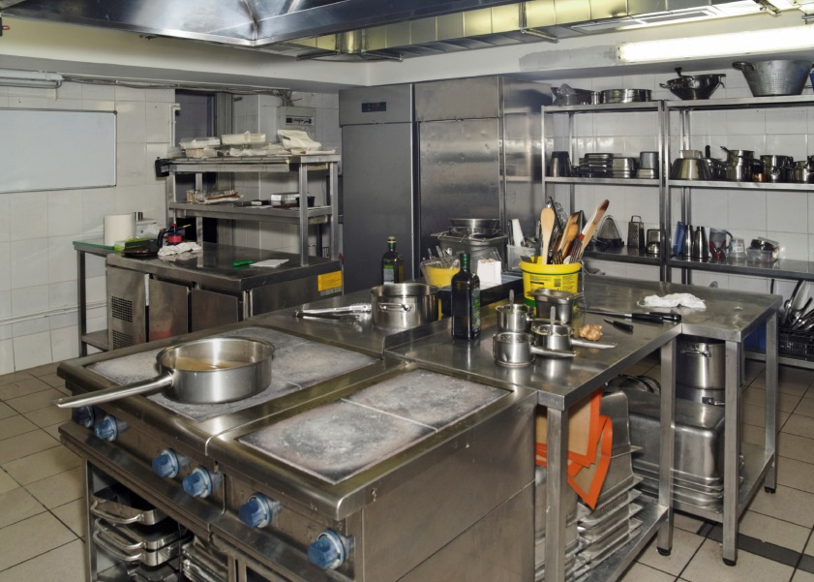
Inspecting “Indoors”
All surfaces are cleaned and dried daily.

Slide 24
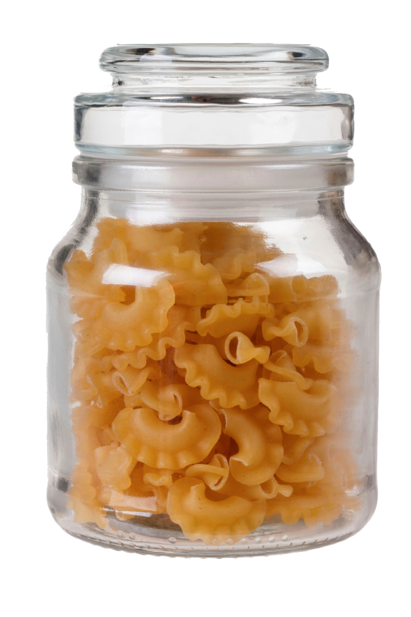
Inspecting “Indoors”
Pasta used for classroom projects should be stored in sealed containers to discourage harboring pests

Slide 25
Inspecting “Indoors”
Seal all backsplashes and fixtures attached to walls.
This keeps cockroaches and ants from harboring around countertops and away from food areas.

Slide 26
Inspecting “Indoors”
Electrical cords and pipes are great runways for pests to access food, water and shelter.
Seal pipe chases and other gaps and holes in walls, ceilings and floors.

Slide 27
Inspecting “Indoors”
Mops and mop buckets should be properly dried and stored (e.g. mops hung upside down, buckets emptied).

Slide 28
Inspecting “Indoors”
Inspect openings around electrical conduits and seal.
Remove trash from lockers and desks and clean out twice a year. They may contain leftover food, which will attract insects and rodents.

Slide 29
Inspecting “Indoors”
Food and Beverages should only be allowed in limited, designated areas and should be cleaned daily.

Slide 30
Waste Management is a Critical IPM Component
Food waste is especially attractive to pests. Keep
all waste bins and dumpsters clean, well maintained,
and empty often. Place on impermeable surfaces
as far from building as possible (minimum 50’).

Slide 31
Inspecting “Outdoors”
Lid should fit tight
Dumpster is too close to the door entrance
Garbage containers, compactors, and garbage storage should be placed 50 feet away from building entrances and lids should fit tight

Slide 32
Inspecting “Outdoors”
Look for signs of deteriorating paint: scrape and sand the surface & repaint (prevents wood rot, carpenter ants and mold).

Slide 33
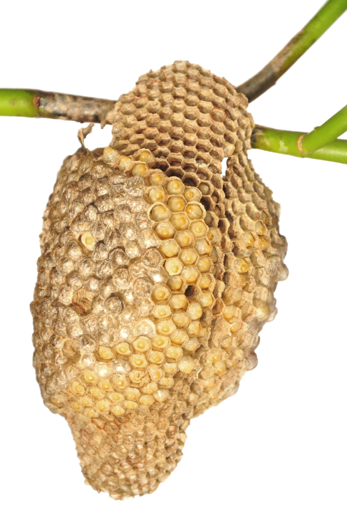
Inspecting “Outdoors”
Building perimeters and playgrounds should be inspected at least every other week during warm weather months to find and destroy wasp nests.

Slide 34
Inspecting “Outdoors”
Weather stripping and door sweeps should be present and in good repair to prevent pest entry.

Slide 35
Inspecting “Outdoors”
Are weeds present in high concentrations on athletic fields?
Are the soils compacted ?
Is the appropriate grass species planted?
Are the grounds irrigated?
Healthy grass

Slide 36
Inspection & Monitoring
A thorough monitoring checklist for school facilities is available at:
thinkfirstspraylast.org/schoolipm

Slide 37
Record Keeping
Record keeping functions as the memory of the IPM program.
Teaches you about the pests
Helps you keep track of controls that have worked or not worked
Helps with communications between employees
Helps form the basis for making decisions
Information is not lost when employees leave or retire

Slide 38
Record Keeping
Who, What, Where & When
Records should show:
Who is doing the monitoring.
What you are monitoring.
Where you are monitoring.
When you are monitoring.

Slide 39
Evaluate Course of Action
Are numbers excessive for type of pest (ants)?
Can pests get out of control (mice, cockroaches)?
Are pests tolerable (grubs)?
Are pests an immediate danger to people (stinging pests)?

Slide 40
Prevention
Practice a high level, of sanitation.
Limit areas where food is eaten.
Store food properly.
Eliminate points of entry.
Modify the pest’s environment don’t provide them food, water or harborage for survival.

Slide 41
Pest Suppression Tactics
Sometimes despite good sanitation and facilities management pests will become more numerous than can be tolerated.
Tolerance limits, called pest thresholds or action thresholds, can vary from one school or situation to another.

Slide 42
Pest Suppression Tactics
Communicate with school staff, students and administrators to establish thresholds for anticipated pests, taking into consideration comfort, risks, opportunities for effective low risk interventions.
When pest monitoring indicates that pests are near or above the threshold, intervention may be called for.

Slide 43
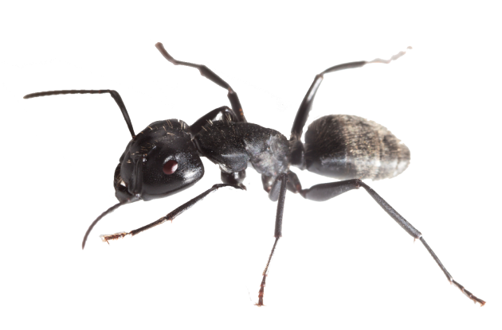
Pest Posing Health Risks
Cockroaches, stinging pests, and rodents require a very low threshold.
Nuisance pests such as pavement ants don’t constitute an urgent threat, therefore more measured approaches and a threshold that allows for a little tolerance are sensible.

Slide 44
Action Thresholds
Defines the point above which specific pests cannot be tolerated
May be based on different criteria;
Potential health risks associated with pests
Pest damage resulting in monetary losses
Aesthetic damage to plants or buildings

Slide 45
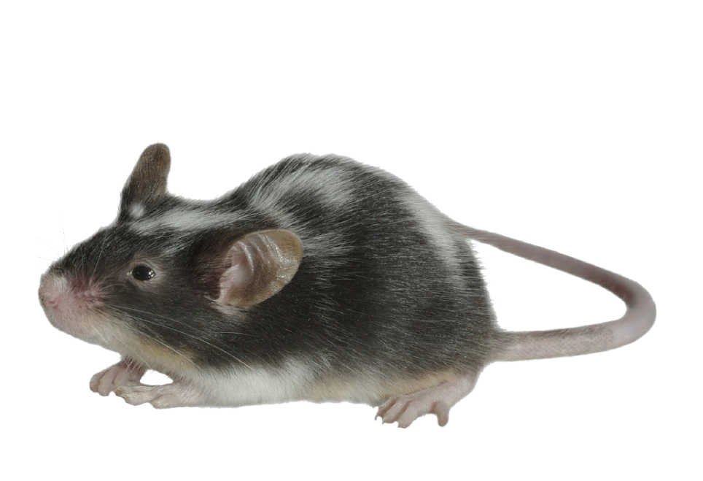
Examples: Action Thresholds
Cockroaches- 1 or more caught on a sticky trap in the school kitchen is too many
Mice – 1 found in any room of the school is too many
**This pest action threshold is for example only. Schools are urged to develop their own.

Slide 46
Intervention activities
Thoroughly clean all floors, surfaces, drains, cupboards, closets to remove all food residues and crumbs.
Deny rodent access to buildings, sealing small holes with steel or copper wool or caulk, sealing gaps around exterior doors with weather stripping, screening openings in all vents and louvers.
Reduce stress on lawns by employing good horticultural practices

Slide 47
IPM Relies on Combinations of Different Pest Intervention Approaches
Cultural
Physical
Biological
And as a last resort
Chemical

Slide 48
Cultural Control
Indoors:
Clean under and behind equipment daily.
Clean all areas daily where ever food is eaten and stored.
Keep kitchens clean and dry.
Keep trashcans in clean and good condition.

Slide 49
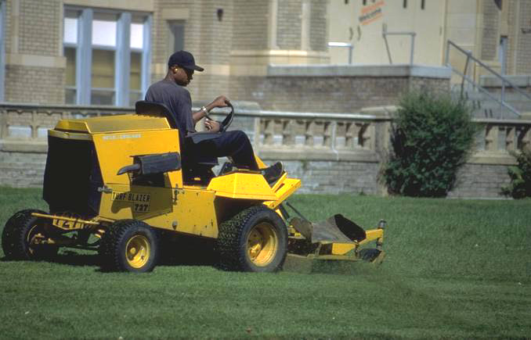
Cultural Control
Outdoors Horticultural:
Landscape and turf- a map should be made to indicate all the trees, shrubs, garden and fields.
Keep plants healthy in the landscape, proper planting, watering, fertilizing and pruning.
Develop a plan for
regularly monitoring those
potential problem pests.

Slide 50
Physical Control
Indoors:
Create barriers
Modify conditions such as temperature, light and humidity
Trapping
Use snap traps for rodents
Sticky traps for roaches
Seal pipe chases and other gaps and holes in walls, ceilings and floors with steel wool or screening material
Storage in tight containers

Slide 51
Physical Control
Outdoors:
Habitat Modification:
Removing dense vegetation near buildings
Eliminating standing water
Removing secondary plant hosts
Planting pest resistant varieties
Barriers:
Window screens, landscape fabric

Slide 52
Biological Control
This type of control targets specific pests and once established can provide long term, or even permanent control.
**Allowing mother nature to work by restricting the use of pesticides, good bugs thrive and help to keep pests under control.
Introduce insect predators and parasites.

Slide 53
Chemical Control
**Chemical control is used as a last resort after other methods have not given adequate control
Or
when the pest poses an immediate risk such as with stinging insects.

Slide 54
Chemical Control
Use a licensed applicator for application in school buildings or on school grounds
Always select the least risky material
Always follow the
directions on the
LABEL

Slide 55
Poison Control Center
To reach a poison control center from anywhere in the United States, call:
1-800-222-1222

Slide 56
Evaluation of effectiveness
Were all the necessary components to the program actually developed?
Were the right people involved in the integration of the components into a whole program?
Was the pest population adequately suppressed?
Was the pest population suppressed in a timely manner?

Slide 57
For more information go to:
extension.unh.edu

Slide 58
Acknowledgements
A special thank you to:
Dr. Robert Corrigan-RMC Pest Management Consulting- Richmond, Indiana
Design: Rachel L. Maccini, Faye Cragin
UNH Cooperative Extension

