Slide 1
BMSB Effects on Shipping Industry
Wallenius Wilhelmsen Logistics
Capt. Phil Hansen
Head of Cargo Quality Americas
2015-06-09

Slide 2
01. Wallenius Wilhelmsen Logistics
02. Past season and actions taken
03. Next season
04. Future

Slide 3
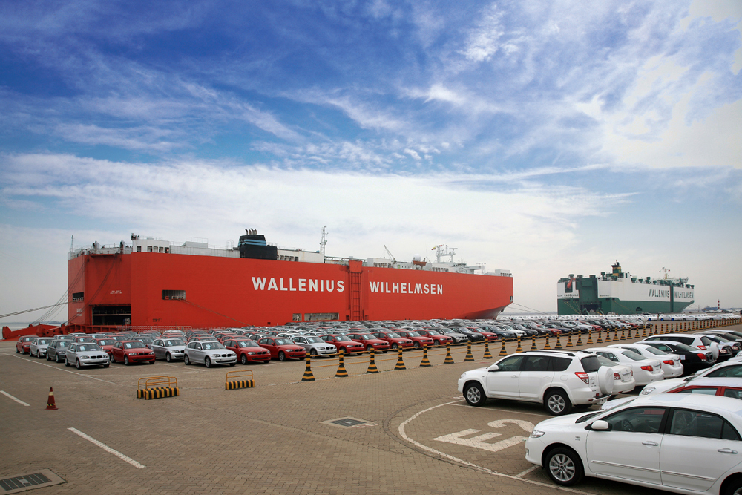
Wallenius Wilhelmsen Logistics

Slide 4
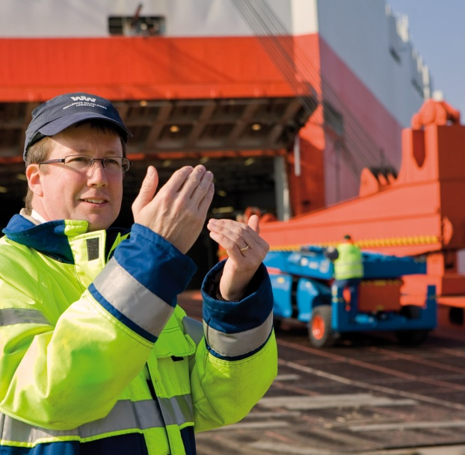
Wallenius Wilhelmsen Logistics
This is Wallenius Wilhelmsen Logistics
Global deep sea ocean network serving 12 different trade routes on a fixed schedule
Specialists in ocean transportation of cars, rolling equipment and break bulk cargo
Operating a modern fleet of approximately 60 PCTC and RoRo vessels, with some of the lowest emission levels in the industry
13 terminals located at strategic ports in UK, Finland, Belgium, China, South Korea and on the US East coast and West coast

Slide 5
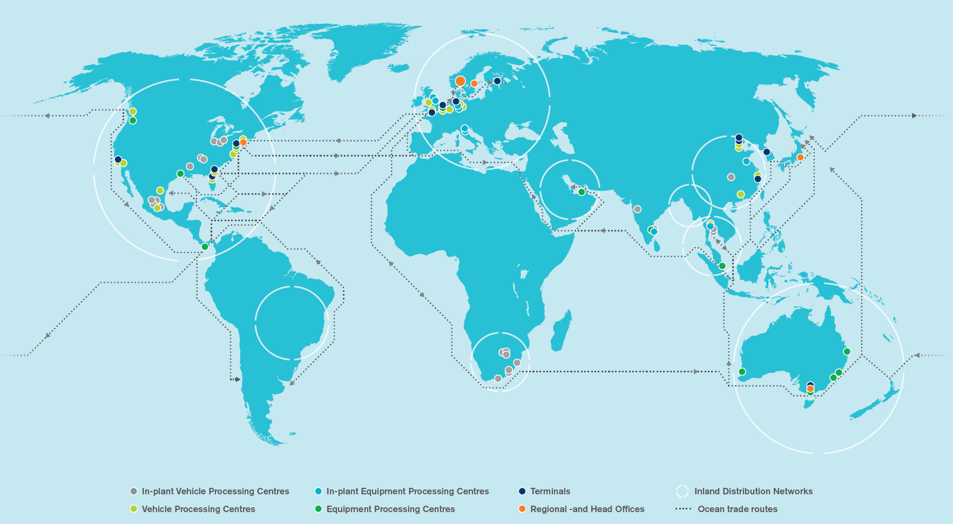
This is Wallenius Wilhelmsen Logistics

Slide 6
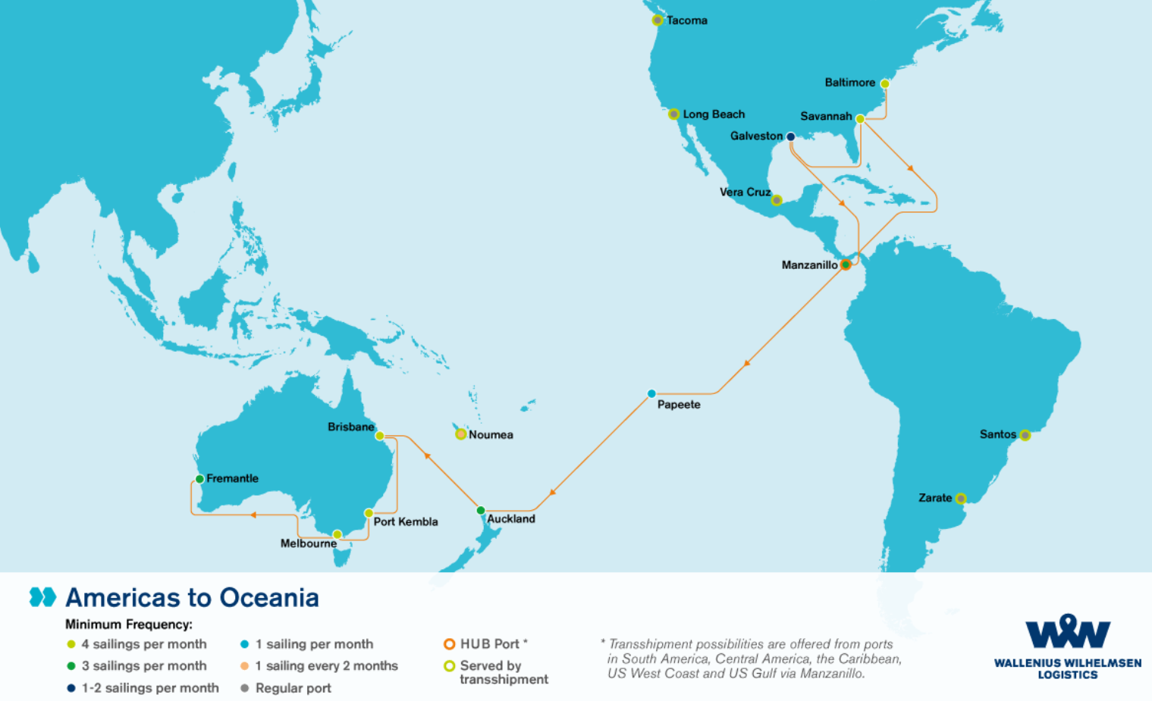
Americas to Oceania
This is Wallenius Wilhelmsen Logistics

Slide 7
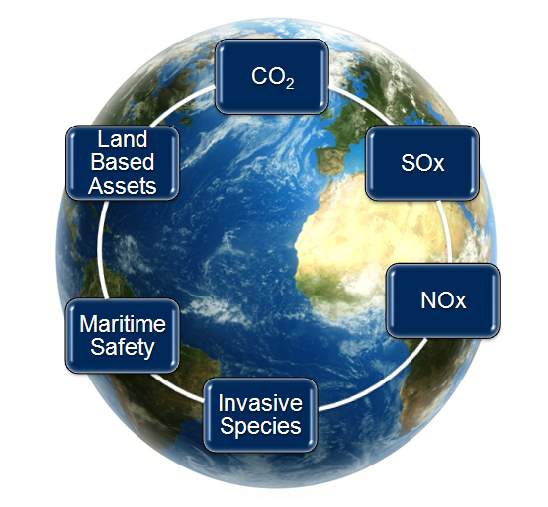
We focus on high impact changes
This is Wallenius Wilhelmsen Logistics
Our environmental work is focused on the areas where it will make the biggest contribution to reducing our impact on the environment
Notes:
Six significant environmental aspects are the foundation for our environmental strategy and actions.
We incorporate the total company operations in our strategy.
We drive continued reduction in environmental impact of our business.
We look for preventive solutions attacking the root cause of the problem.

Slide 8
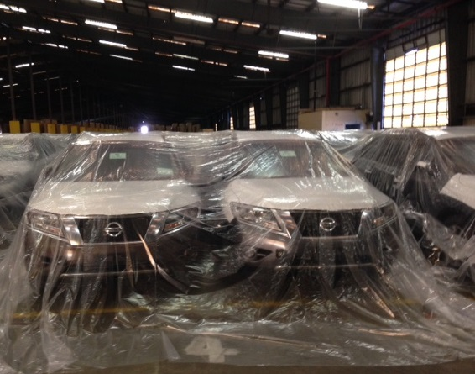
Past season and actions taken

Slide 9
How it all started
Past season and actions taken
Dec 2014 – Jan 2015
NZ - Isolated bugs have been found on various pathways for many years with increasing numbers recently
NZ-Nov - dead bug found on imported new vehicle by mechanic
NZ-Dec - 1st aggregated population; multiple active bugs found by stevedore inside new vehicle, consignment heat treated
NZ-Dec - 2nd aggregated population found only after heat applied; BMSB scattered across variety of cargo.
AUS-Dec - 21 Trucks were quarantined in Brisbane.
NZ-Dec - 10 units were not discharged in Auckland.
NZ-Dec - All Auckland cargo ex-Savannah was refused in port of discharge.
AUS-Jan - Savannah cargo for Port Kembla refused for discharge.
AUS-Jan – Trucks ex-Savannah refused in Brisbane
AUS-Jan - Savannah H&H and B/B refused in Port Kembla

Slide 10
Pre-treatment requirements in Oceania
Past season and actions taken
New Zealand
23rd December
All cargo from USA requires treatment
Currently pre-treatment required year around
Australia
23rd February East Coast
9th March all of US
30th April pre-treatment requirements ended
Arrival of vessel to an AUS port
Pre-treatment in the US until end of March
1st Sep Approximate date for start
DOA and MPI visit to US East Coast end January

Slide 11
Consequences
Past season and actions taken
General
Vessel scheduling
Uncertainty leading to increased speed and higher fuel consumption – environmental impact
Utilization of vessel space
Initially light vessels - later capacity problems
Documentation challenges
Treatment certificates – AUS / NZ unclear requirements
Cross-contamination
Treated cargo placed next to untreated cargo (season)
Transshipment cargo not affected by requirements
Cargo to Asia
US
Customer pre-treatment preferences
Logistics and terminal problems.
Cargo piling up in ports
Challenges with treatment scheduling / time windows
AUS 96h / NZ 72h
Oceania
Vessel delays about 2 days per vessel
Sometimes 16h/port (AUD 8000/port)
Logistics and terminal problems
Cargo piling up
Scheduling of dock worker shifts
Vessel rest hour

Slide 12
Actions taken by WWL
Past season and actions taken
Pre-treatment in US ports
Setting up temporary pre-treatment solutions Methyl Bromide / Heat / Sulfuryl Fluoride (ProFume)
Baltimore and Savannah (main volumes)
Galveston, Long Beach, Tacoma
Managing port/terminal space shortage
Used existing warehouse space and leased new when needed
Planning for additional warehouse space in Baltimore
Year around treatment of used mobile homes
WWL imposed

Slide 13
Baltimore Volumes 2014
Past season and actions taken

Slide 14
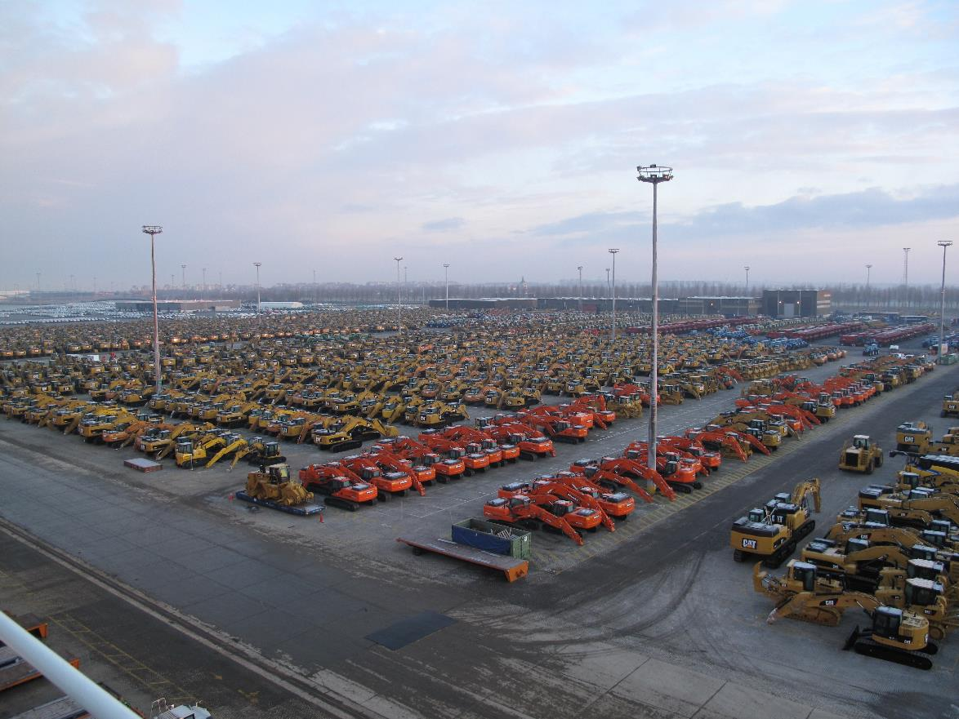
High and Heavy cargo (ZEE)

Slide 15
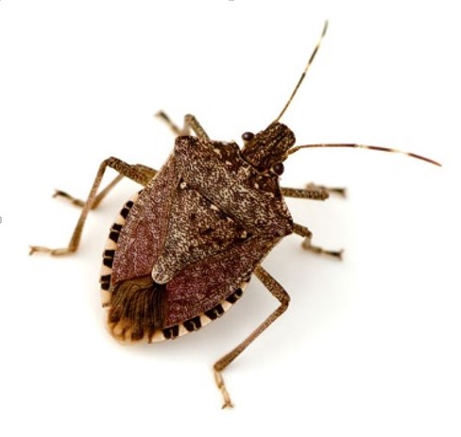
Next season

Slide 16
Next season
Next season
Governmental and international alignment needed
A common pre-treatment for AUS and NZ (Bug season)
Time windows (AUS-96 / NZ-72)
Treatment options (Same bug – same treatment should be possible)
Cross contamination in terminals and during transit (transshipment cargo)
Forwarding of costs towards cargo owner
AUS-DOA and NZ-MPI alignment meeting in Canberra 13th May

Slide 17
Future

Slide 18
Research and initiatives needed
Future
Treatment methods (Capacity increase)
Heat
Reduction in treatment temperature and time?
WWL Hotbox in Savannah used for tests by Virginia Tech (50/day)
MPI not satisfied
Sulfuryl Fluoride (ProFume) Other gas?
Reduction in treatment temperature, time and concentration
USDA performing tests at the University of California
Environmental and safety concerns
Indicators of bug presence
Inspection methods (Thermal fogging)
Traps (Indicators)
Design of traps
Vessels/terminals
Characteristics of the BMSB
Lifecycle
Adult / youth bugs surviving the winter?
Eggs – on cargo or only leafs?
Hibernation
Daylight + Temperature
Cargo hold
Wake up time
In cargo hold during transit?
Questions?
Future of ProFume
Other treatment options

Slide 19
Future
Future
Government support
Shipping region
Pre-treatment Infrastructure with environmental focus
Segregation and bio security areas in terminals
Alignment of requirements and knowledge sharing
Increased knowledge and understanding of industrial impact (logistics industry)
Receiving region
Capabilities to house and treat cargo if needed
Alignment of requirements and knowledge sharing
Increased knowledge and understanding of industrial impact (logistics industry)
Global biosecurity concerns
What is next?
BMSBs in other areas/regions
Other type of bugs/pests
How can the industry prepare?

Slide 20
WWL Vessels
This is Wallenius Wilhelmsen Logistics

Slide 21
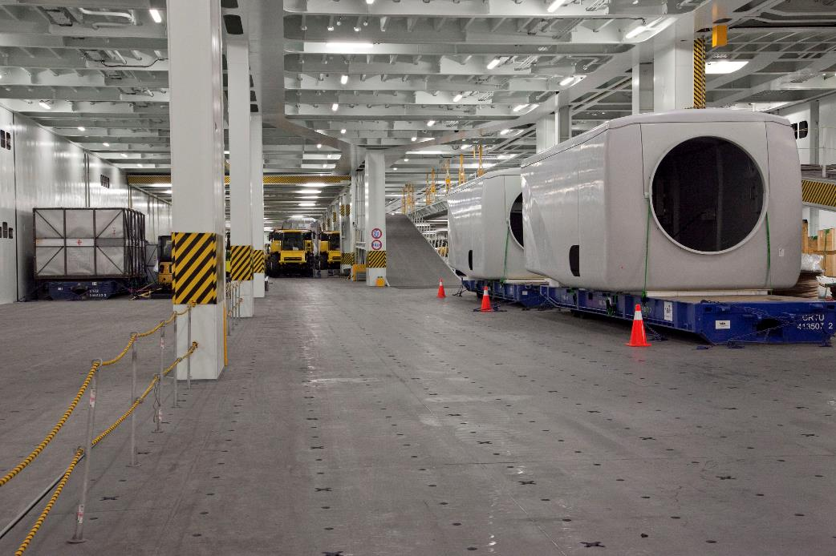
WWL Vessels
This is Wallenius Wilhelmsen Logistics

Slide 22
Finally some risks
This is Wallenius Wilhelmsen Logistics
USA
Increased environmental impact
Fumigants
Manufacturing jobs
Trade barriers
Oceania
Frequency of vessel calls

