Slide 1

BMSB Research in
New Zealand
David Teulon (B3 Director)
BMSB IPM Working Group
9 June 2015
College Park, MD

Slide 2
Better Border Biosecurity (B3)
Research themes
Risks: what are the pests and diseases of risk to NZ?
Pathway risk management: what are the high risk pathways and how to close/manage them?
Diagnostics: can we categorize them when they get here?
Surveillance: can we improve the tools to detect incursions as early as possible?
Eradication: can we improve the tools to improve our chances of their eradication?
Notes:
B3 projects structured around answering these very simple question

Slide 3
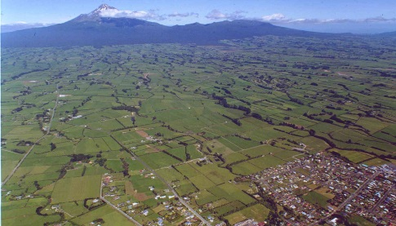
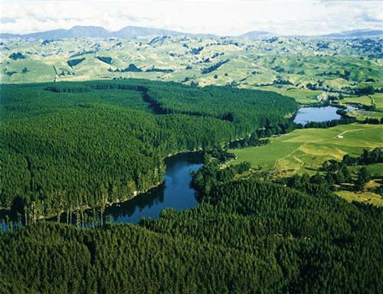
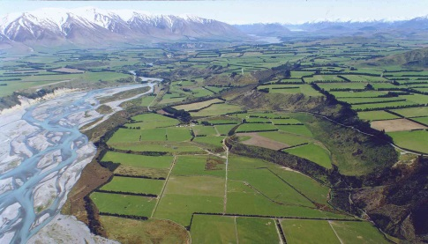
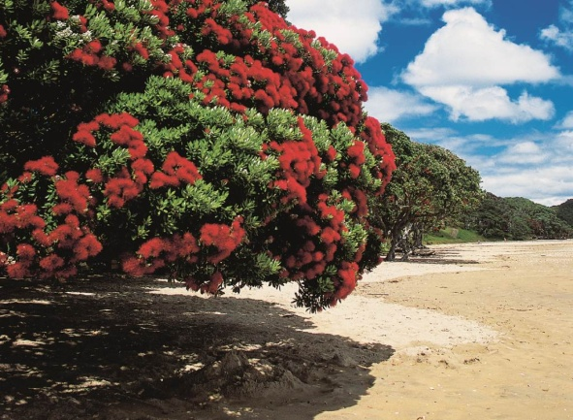
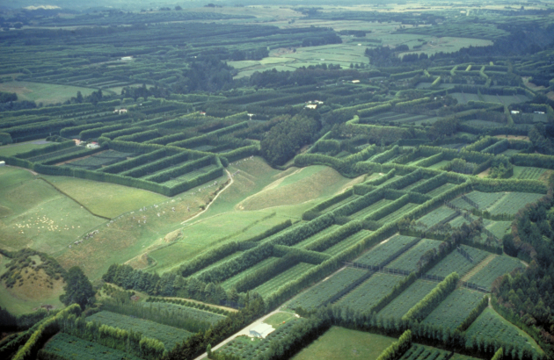
New Zealand Border Biosecurity
Plant based productive sector is essential to NZ’s economic well-being
NZ only first world economy based on plant productive sector
Indigenous flora is unique and central to our culture and tourism
Productive and natural systems are subject to invasion by unwanted and destructive exotic organisms
Growing passenger and trade volumes, increasing imports from new countries, population expansion and climate change
Rate of incursion is likely to continue to increase
Notes:
See slide

Slide 4
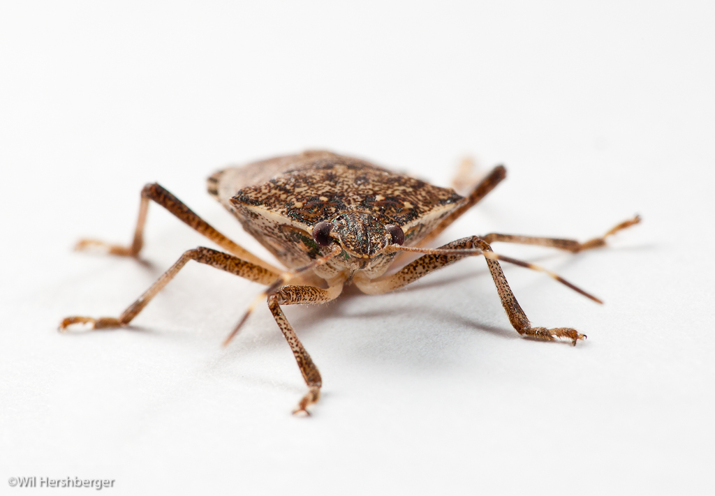
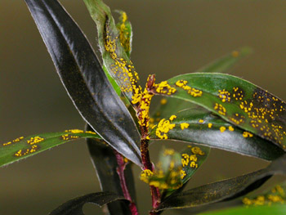
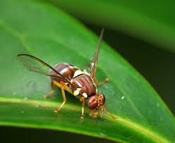
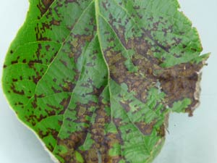
New Zealand Border Biosecurity
Ineffective border biosecurity:
Undermine base production
Limits our future options
Security: interrupted supply
Safety: residue free threatened
Integrity: NZ trade questioned

Slide 5
Biosecurity: An Industry Priority

Slide 6

Biosecurity: A Government Priority
“biosecurity is my number one priority”
Notes:
Everyone here has probably heard me say many times that “biosecurity is my number one priority as Minister.”

Slide 7
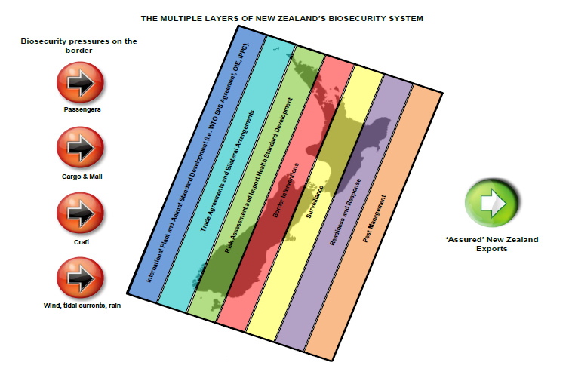
New Zealand’s Biosecurity System

Slide 8



Range of biosecurity threats
Known, Knowns
(e.g. Fruit Flies)
Known,
Unknowns
(e.g. BMSB)
Unknown
Knowns
(e.g. PSA)
Unknown,
Unknowns
(e.g. Liberibacter)
Notes:
Another way of looking at our challenges relates to the well known biosecurity mutterings of Donald Rumsfeld
There are known knowns; there are things we know that we know.
There are known unknowns; that is to say, there are things that we now know we don't know.
But there are also unknown unknowns – there are things we do not know we don't know.
United States Secretary of Defense, Donald Rumsfeld
Each of these is likely to have a different approach

Slide 9
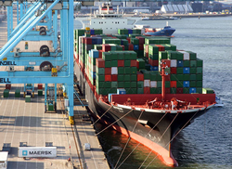
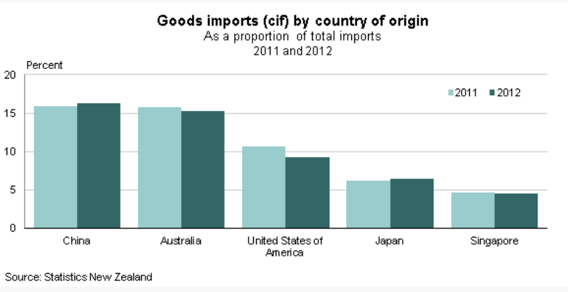
US -> NZ trade
US is significant trading partner with NZ

Slide 10
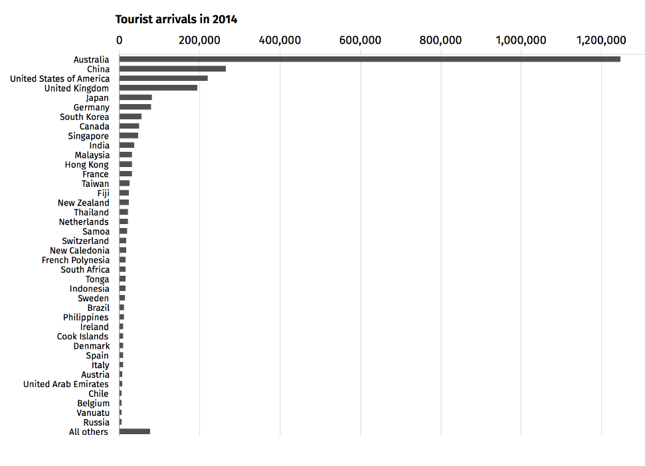

US -> NZ tourism
US makes up many of the tourists visiting NZ

Slide 11
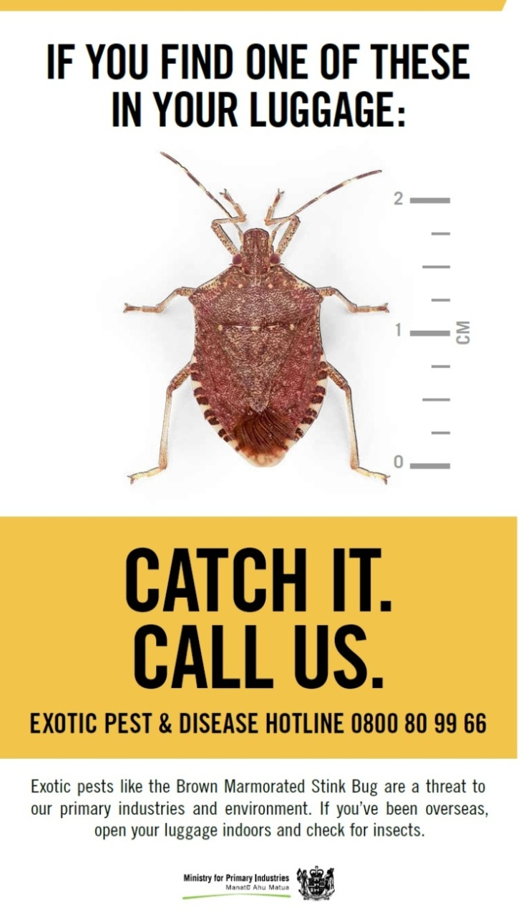
BMSB – New Zealand Response
1996-98: Invasive species established in Nth America
2008-10: Increasing (serious) issues in the US
Nov. 2012: MPI (NZ) risk assessment
May 2014: Leskey keynote at B3 (NZ) Conference
Aug. 2014: Industry/MPI/B3 working group established (research prioritisation)
Dec. 2014. Increased public awareness campaign especially at Auckland Airport
Feb. 2014: Treatments for vehicles from US
Planned collaboration between NZ (B3) and Australia (PBCRC) to maximise use of resources

Slide 12
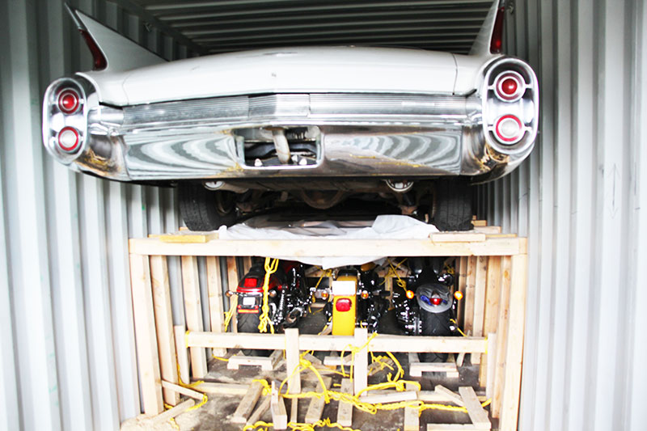
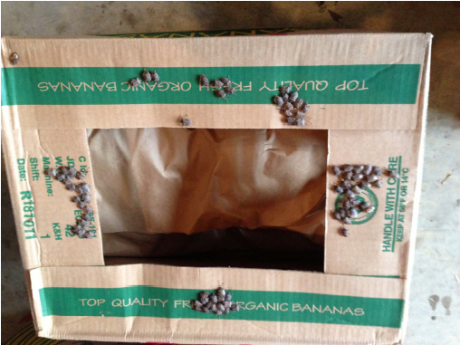
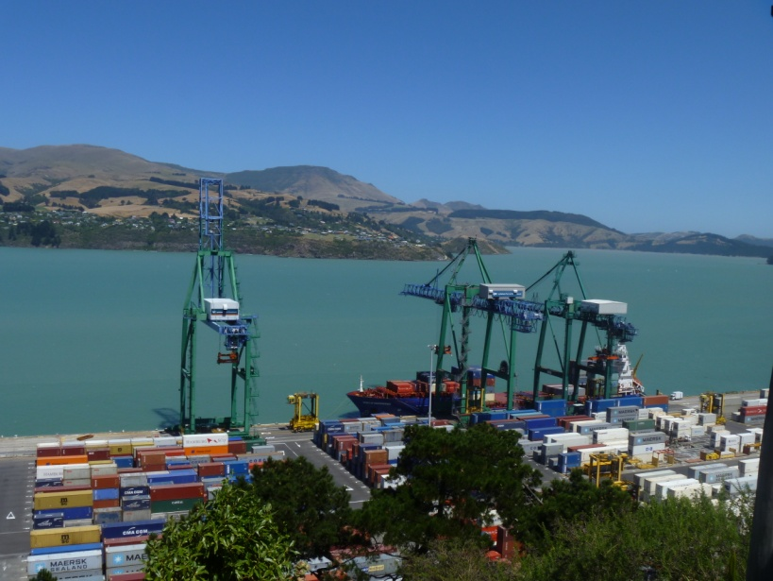
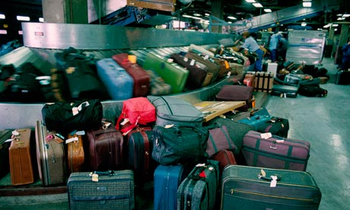
BMSB entry to New Zealand
October 2014 to March 2015
  34 interceptions across a range of imported goods and pathways (vehicles, sawn timber, personal effects)
  13 involved live bugs
Vehicles and machinery from the US
  Non-containerised - treated prior to shipment
  Containerised - treated prior to arrival
Enhanced inspections at the border
Household goods from US are now directed for de-vanning only at MPI-approved transitional facilities

Slide 13
Project | NZ researcher | US collaborator
Risk assessment
Geographical distribution | B3 / Phillips et al. | BISON & other
Pathway management
Pathway detection | B3 / Brockerhoff et al. | David Lance (USDA)
Detector dogs | MPI / Duthie et al. | USDA Georgia
Treatments for imports | B3 / Hall & Najar-Rodrigeuz | Spencer Walse (USDA)
Surveillance
Optimising lures | MPI / Duthie et al. | Tracy Leskey (USDA)
Multiple lures | MPI/ Suckling et al. | Peter Shearer (OSU)
Sniffer bees | B3 / Suckling & Harper | Don Weber (USDA)
Natal origins | B3 / Armstrong et al. | Tracy Leskey (USDA)
Eradication
Sterile Insect Technique | B3 / Suckling & Welch | Jim Carpenter (USDA)
Lure & kill | Suckling et al | Peter Shearer (OSU)
Pest management
Pre-emptive classical biocontrol | B3 / Charles et al. | Kim Hoelmer (USDA)

Slide 14
Risk assessment
MPI/Duthie (2012): containers, vehicles, machinery - highest, establishment - high, spread - high, economic consequences - medium to high, environmental - low, socio-cultural - medium
B3/Senay et al. (ongoing): Climate modelling (> 6 models) all predict parts of NZ are suitable for BMSB but disagree as to which parts
B3/Charles (2014-15): Pre-emptive risk assessment for BCAs, based on de-pauperate Pentatomid fauna and their distribution, suggests we might have options

Slide 15
Pathway management
MPI/Duthie (2012): containers, vehicles, machinery – highest risk
MPI instigated treatment in Dec 2014 of vehicles from US based on USDA treatment data and other measures
MPI initiating training for detector dogs with USDA Georgia
B3/Jamieson: Systems approach to pathway risk management (BMSB)
B3/Rostas/Brockerhoff et al. (2 x PhDs, ongoing): chemical and acoustic detection in confined areas with USDA/DHS (JCM)
B3/Hall & Najar-Rodrigeuz (under development): off-shore treatments for BMSB with USDA (JCM)
What about Asia? All recent Europe incursions from there!

Slide 16
Diagnostics
Defining Land Biota (LCR): Fauna of NZ key to pentatomidae
MPI pamphlets: Catch it, Call us
B3/Armstrong & Holder (ongoing): stable isotopes to indentify whether new or established population and origin
Wall chart / easy ID key for home gardeners / growers?

Slide 17
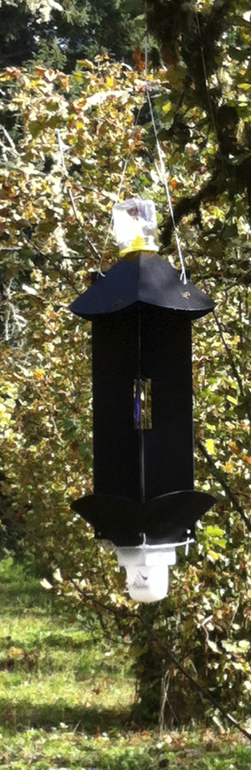
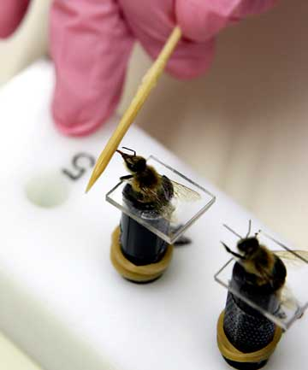
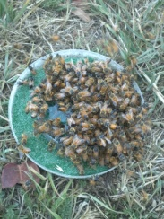
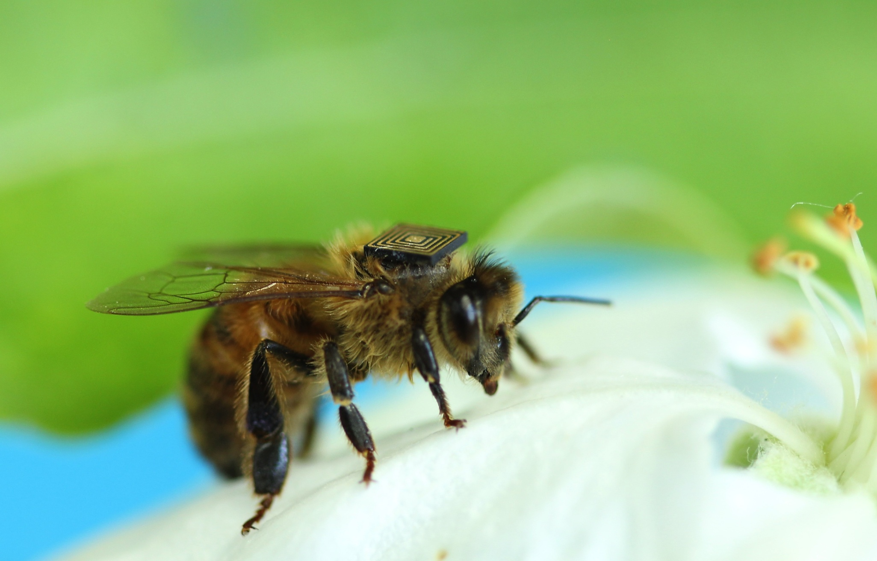
Surveillance
MPI/B3 (ongoing?): multiple species traps/lures – targeting fruit flies, Gypsy moth, bark beetles, BMSB
  B3/Suckling & Skinner: panel vs pyramid traps
MPI: Fit for purpose BMSB traps for border surveillance/delimitation/eradication
  pulling distance” of the lure and the proportion of the population detected at low population densities
B3/Suckling: Bees trained to indicate biosecurity targets – a new generic surveillance tool at landscape scale?

Slide 18
Eradication & Response
B3/Suckling: Sterile Insect technique
B3/Suckling: Lure and kill

Slide 19
Questions

