Slide 1
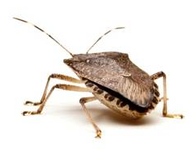
Northeastern BMSB Updates

Slide 2
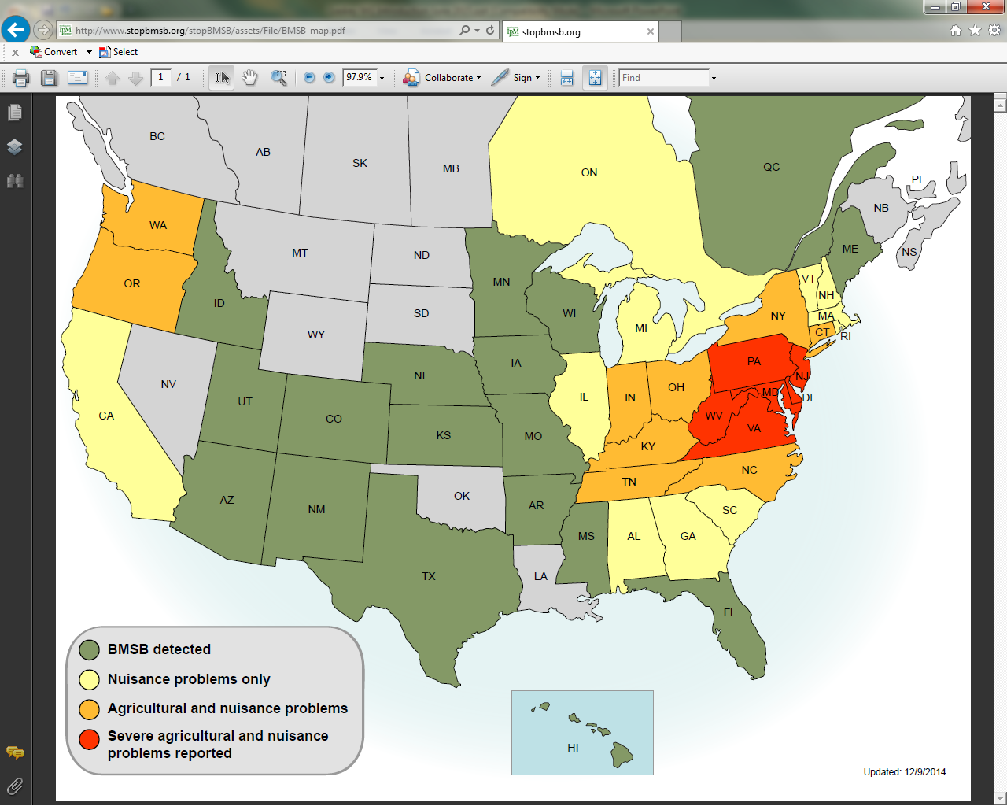

Slide 4
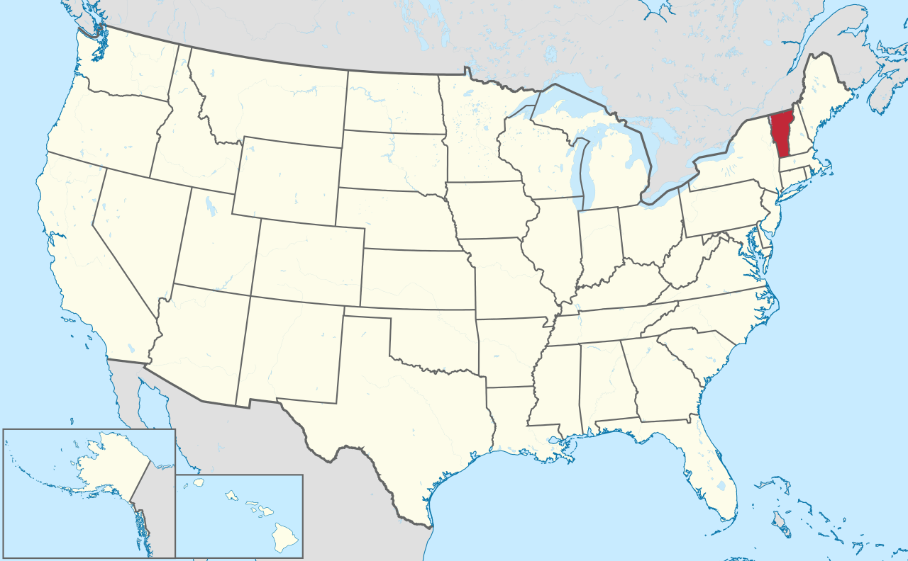
To the best of my knowledge, BMSB has not been identified as an agricultural nor nuisance pest (yet) in Vermont. It has, however, been confirmed here.
-Terry Bradshaw, University of Vermont

Slide 5
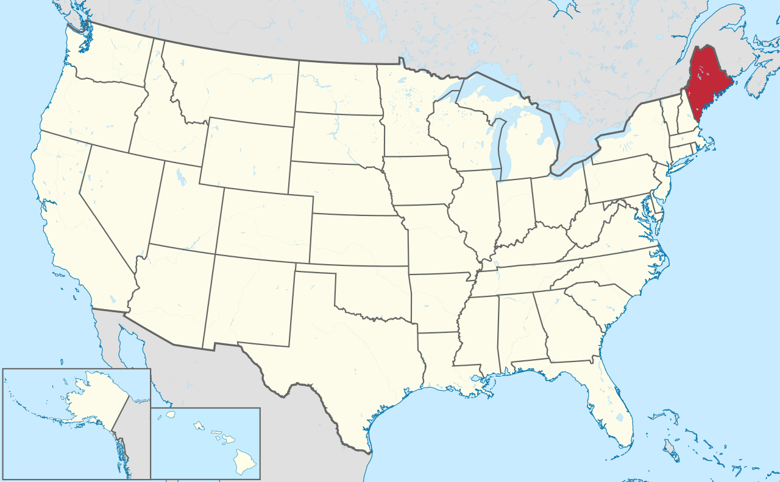
“Ditto” what Terry said for Maine.
-Glen Koehler, University of Maine

Slide 6
As of June 4, 2015, we (State Entomologist Piera Siegert, and Rachel Maccini & Alan Eaton, UNH Cooperative Extension) have confirmed BMSB specimens from 21 municipalities in New Hampshire. Nearly all of the specimens were in or on buildings.
One report came from a infested nursery (where the plants had just been imported from Long Island, NY), and two individuals were found in a BMSB trap.
Only one community (Portsmouth) commonly reports nuisance problems. All reports of “BMSB” on agricultural crops have turned out to be other species, especially squash bug or brown stinkbug.
- Alan Eaton University of NH Cooperative Extension

Slide 7
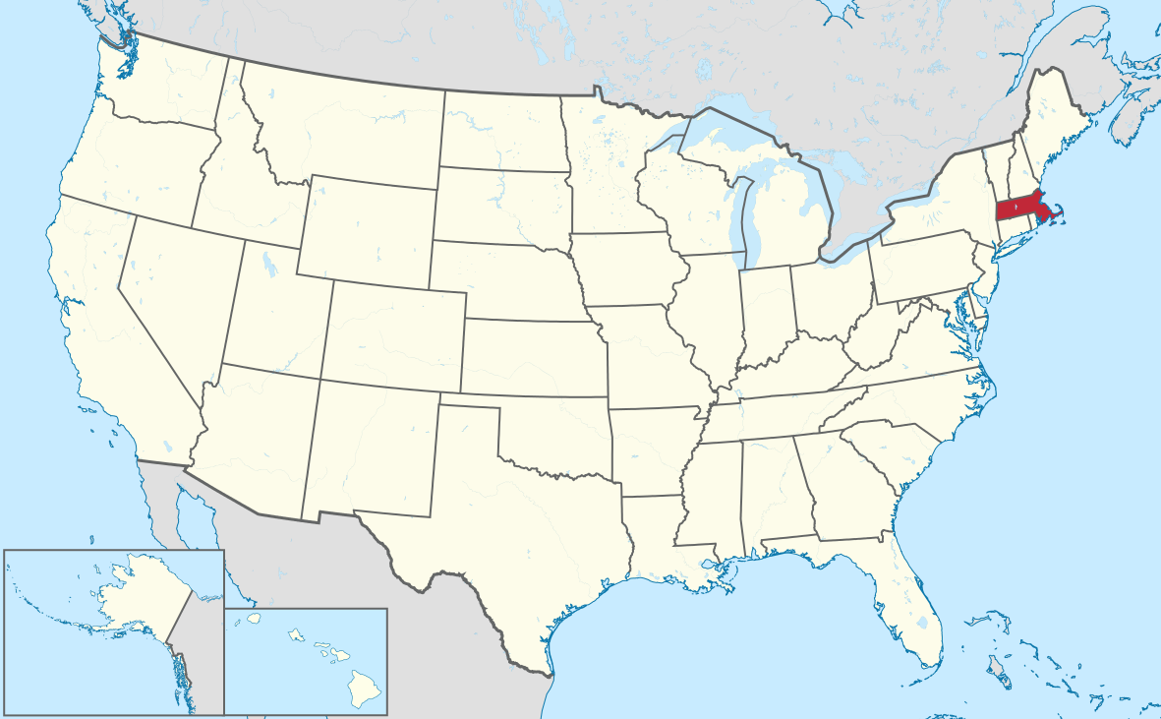
There have been trap captures in agricultural settings (just a few here and there). No reports of agricultural injury or nuisance pest problems.
Homeowners with ones and twos indoors in some locations.
-Kathleen Leahy, Polaris

Slide 8
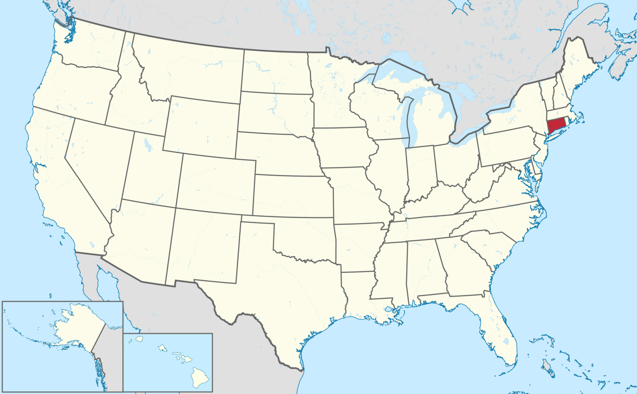
Connecticut
Present in every county.
Populations exploded in the central part of the state.
Now an agricultural pest in orchards.
Scouting and trapping in fruits and vegetables to determine if an agricultural pest throughout the state or in pockets.
Mary Concklin, University of Connecticut

Slide 9
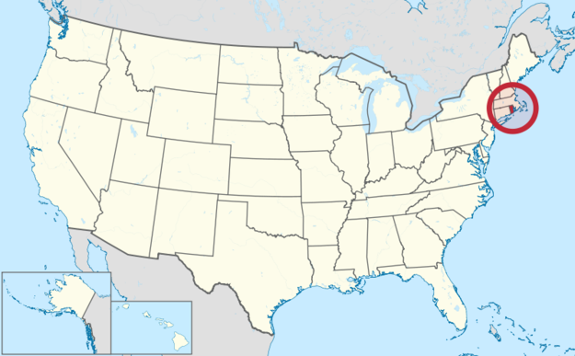
Rhode Island
No nuisance or agricultural problems.
They see a few each year, but not many.
Very few Ailanthus trees in RI, wonders if that is helping.
Heather Faubert, University of Rhode Island

Slide 10
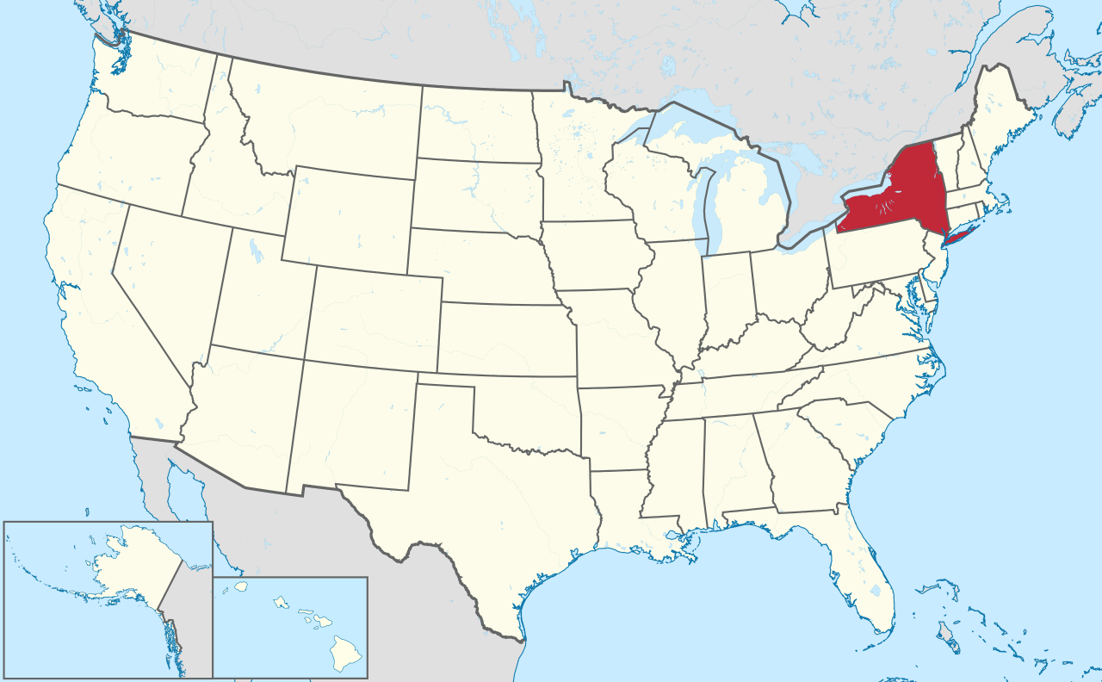
BMSB first detected in 2007.
Well established in the Hudson Valley, with damage in late apple varieties in Orange, Dutchess and Ulster Counties (~20% at pack-out in 2012). Now using provisional thresholds developed by USDA / ARM sprays. Reduced damage to 1.5%.
Populations remain low in western NY, with no damage to agronomic crops.
Now established on Long Island, though no reports of damage.
Art Agnello, Cornell University

Slide 11
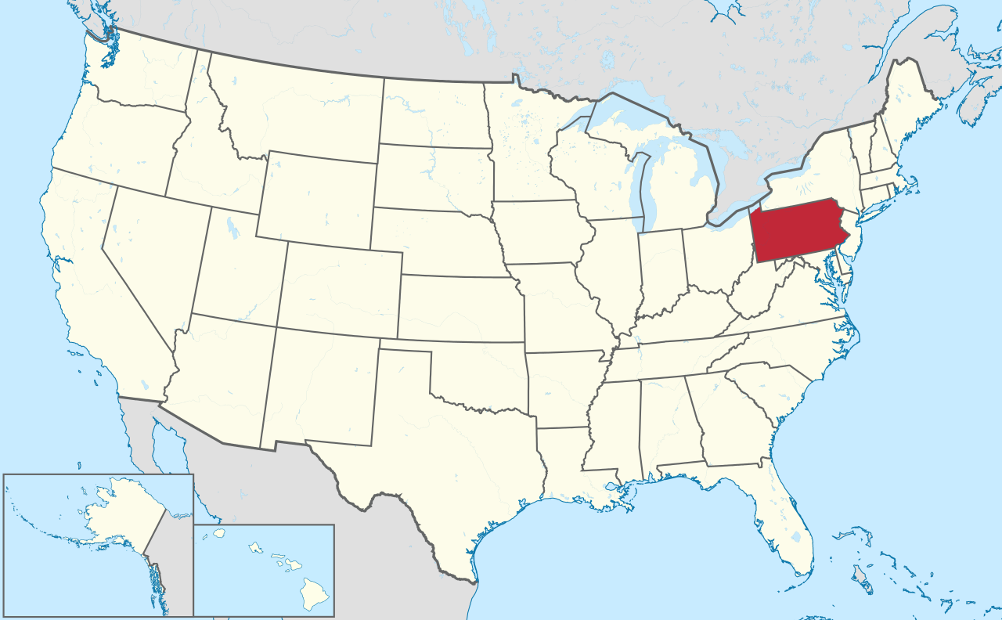
Present throughout the state.
Populations largest in the southern half of state up to Harrisburg line. Minimal in northern part of state.
Serious agricultural pest, but with hit or miss situation with presence of damaging population on fruit. Some places with higher and lower populations over 2013 and 2014.
Monitoring is key to successful management. Fruit growers using it from mid-July onward. Using nymphs as a trigger in traps.
Greg Krawczyk, Penn State

Slide 12
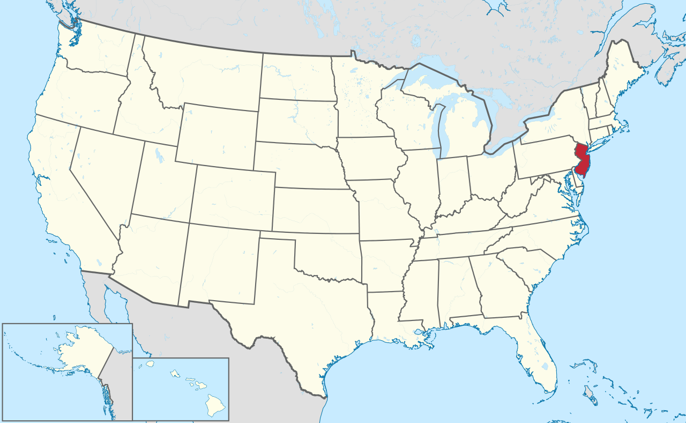
Populations present throughout the state.
Populations down in a lot of urban and agricultural areas.
Having said that, still a significant issue. Requires intervention.
George Hamilton, Rutgers

Slide 13
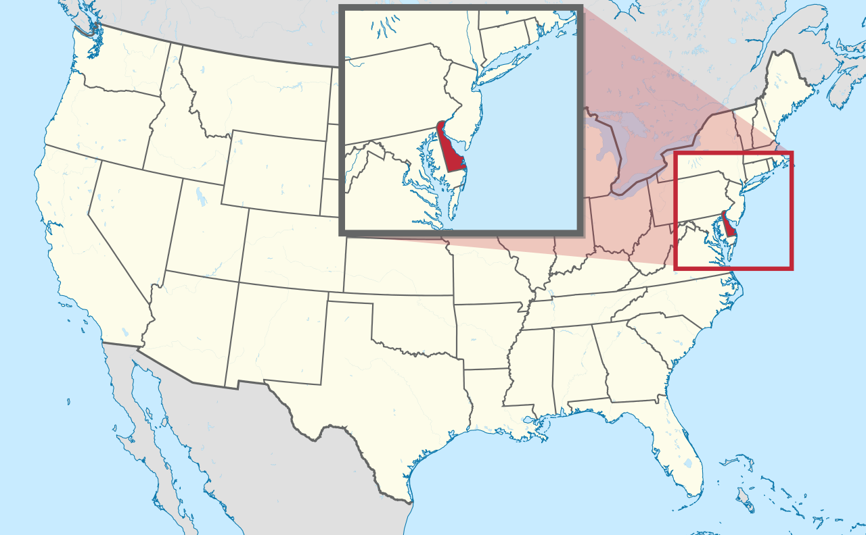
Currently, low levels in light traps (2-3/week). Nothing in pheromone traps yet.
Some homeowners felt spring numbers similar to spring 2011 (low numbers then).
Cissel, W.J., C.E. Mason, J. Whalen, J. Hough-Goldstein and C.R.R. Hooks. 2015. Effects of BMSB Feeding Injury on Sweet Corn Yield and Quality. J. Econ. Entomol. http://dx.doi.org/10.1093/jee/tov059
Joanne Whalen, University of Delaware

Slide 14
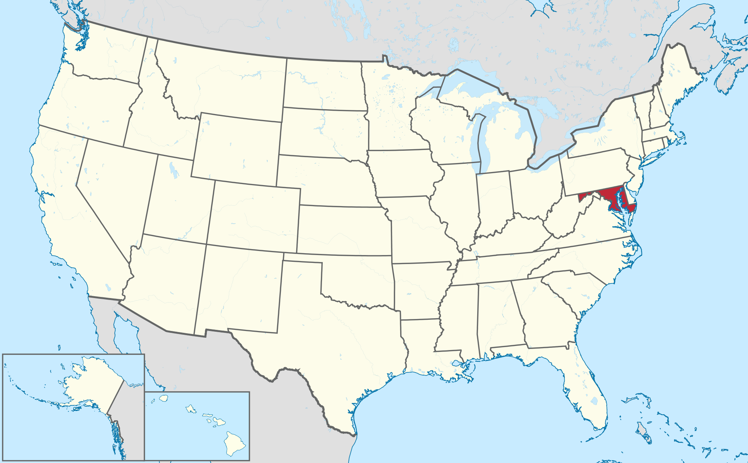
Serious agricultural and nuisance problems in Western Maryland. Fewer on Eastern Shore.
Growers continue to treat specialty crops and row crops.
Fewer in 2014 than in years past. A lot of winter kill.
Introduction of T. japonicus.

Slide 15
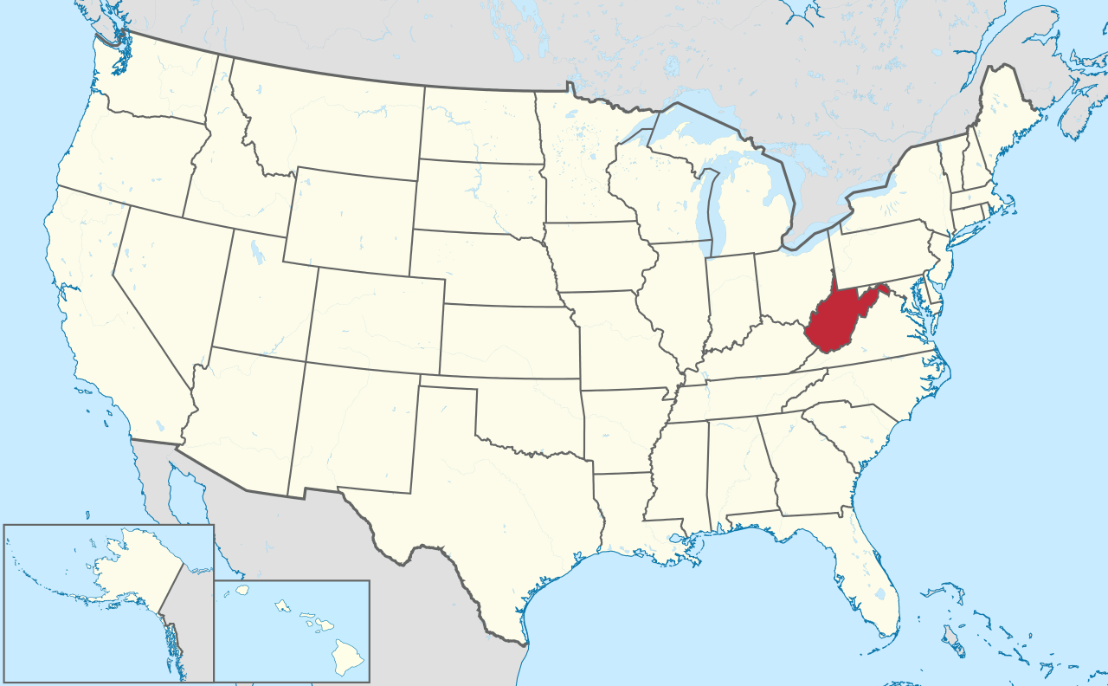
Serious agricultural and nuisance problems in the eastern panhandle and near Morgantown.
Growers continue to treat specialty crops and row crops.
Fewer in 2014 than in years past. A lot of winter kill.

