Slide 1
Status of BMSB in the Southern Region
Jim Walgenbach
Dept. Entomology, NC State University
Mt Hort Crops Res & Ext Ctr
Mills River, NC

Slide 2
Status of BMSB in the
Southern Region
Distribution
  Detections
  Established Populations
Research & Extension Activities

Slide 3
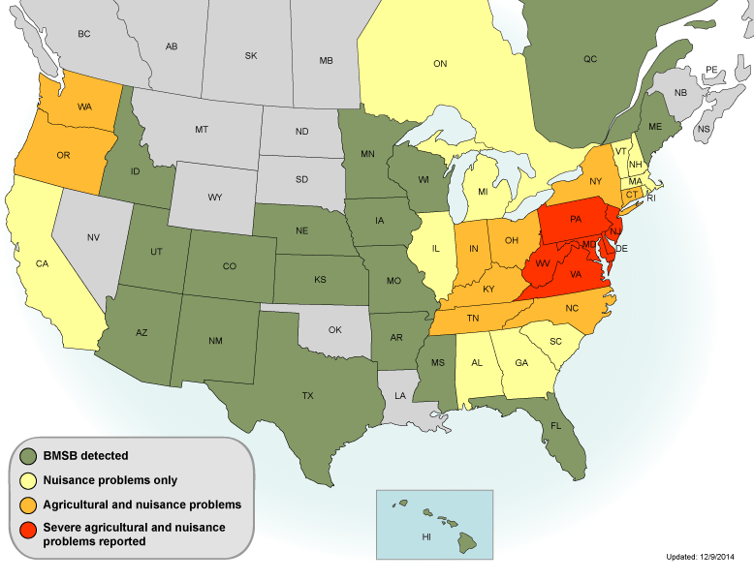
NC

Slide 4
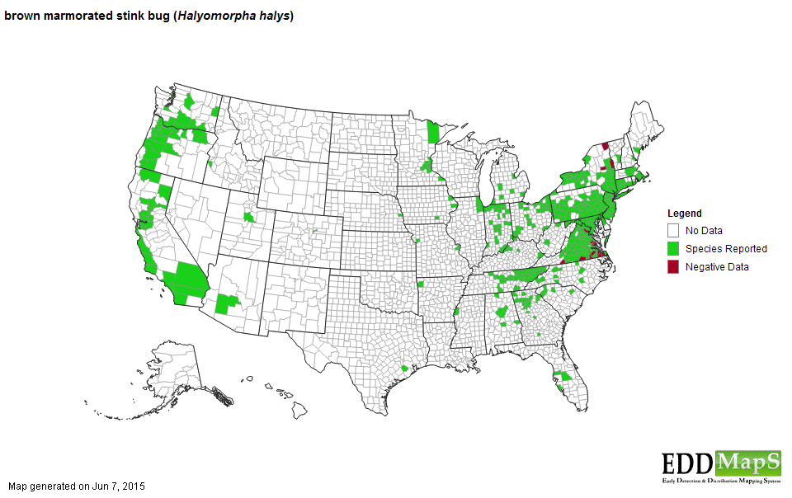

Slide 5
Acknowledgments
Alabama
  Charles Ray
Arkansas
  Donn Johnson
  Sam Kim
Florida
  Amanda Hodges
Georgia
  Mike Toews
Kentucky
  Ric Bessin
Louisiana
  Alan Morgan
Mississippi
  Blake Layton
South Carolina
  Powell Smith
  Andy Rollins
Tennessee
  Jenny Moore
  Scott Steward
Texas
  Mike Merchant
Virginia
  Ames Herbert
  Tom Kuhar

Slide 6
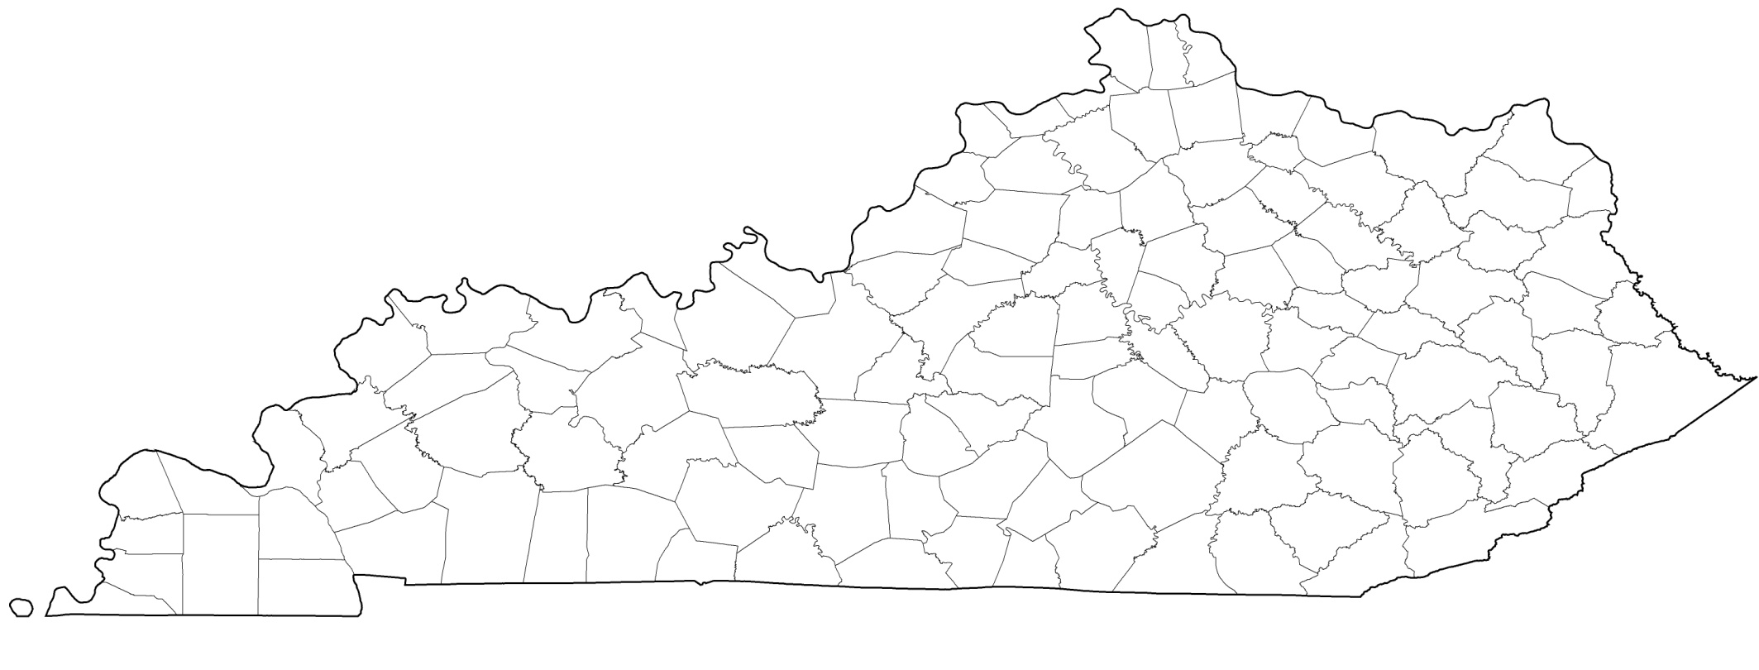
Brown Marmorated Stink Bug Timeline
57/120 counties
2010/11 (6 counties)
2011/12 (2 counties)
2012/13 (19 counties)
2013/14 (30 counties)
Suspected, but no samples
Louisville
Lexington

Slide 7
Brown Marmorated Stink Bug Distribution
2008-2014
HAWKINS
SULLIVAN
JOHN-SON
CLAY
PICKETT
SCOTT
CAMPBELL
CLAIBORNE
HANCOCK
CARTER
STEWART
MONTGOMERY
ROBERTSON
SUMNER
MACON
JACKSON
OVERTON
FENTRESS
GRAINGER
GREENE
WASH-
INGTON
LAKE
OBION
WEAKLEY
HENRY
CHEATHAM
TROUSDALE
SMITH
MORGAN
UNION
HAMBLEN
UNICOI
DAVIDSON
WILSON
PUTNAM
ANDERSON
JEFFERSON
COCKE
BEN-TON
HOUSTON
DICKSON
CUMBERLAND
KNOX
DYER
GIBSON
CARROLL
HUMPHREYS
DEKALB
WHITE
ROANE
SEVIER
WILLIAMSON
RUTHERFORD
CANN-ON
LOUDON
BLOUNT
CROCKETT
HICKMAN
WARREN
VAN BUREN
BLEDSOE
RHEA
LAUDERDALE
HENDERSON
DECATUR
PERRY
MAURY
MEIGS
MCMINN
MONROE
HAYWOOD
MADISON
LEWIS
MARSHALL
BEDFORD
COFFEE
TIPTON
CHESTER
GRUNDY
SEQUATCHIE
HAMILTON
HARDEMAN
HARDIN
WAYNE
LAWRENCE
GILES
MOORE
FRANKLIN
BRADLEY
POLK
2008 Confirmed
2009 Confirmed
2010 Confirmed
2011 Confirmed
2012 Confirmed
2013 Confirmed
2014 Confirmed
SHELBY
FAYETTE
MCNAIRY
LINCOLN
MARION

Slide 9
BMSB In Georgia
Confirmed Counties (21)
Notes:
BMSB has been confirmed in 21 Georgia counties. For the first time, reproducing BMSB populations were confirmed in an ornamental nursery, pecan production, peach production, cotton production, and directly adjacent to blueberry production (scouting was too late in the season for blueberries to be present). Based on the current county map, we think it is highly likely that BMSB is present in most of, if not all, northern and central counties.

Slide 10
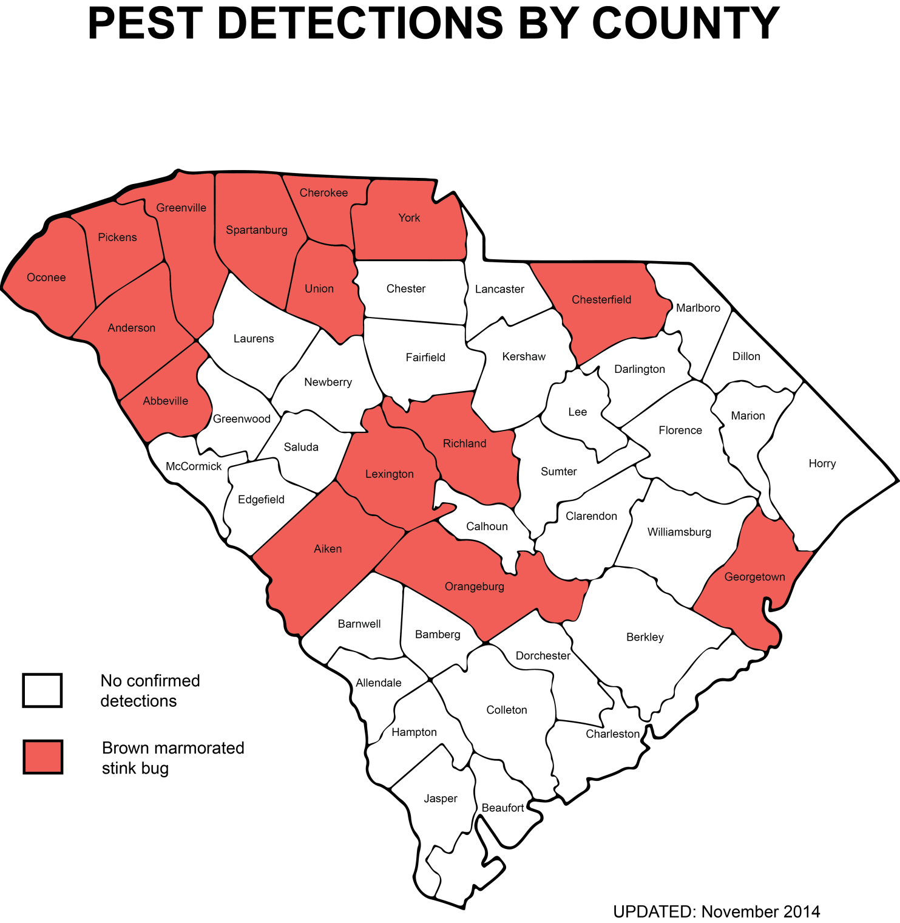

Slide 11
Brown Marmorated Stink Bug Distribution in North Carolina:
ASHE
ALLEGHANY
SURRY
STOKES
ROCKINGHAM
NORTH-AMPTON
GATES
CAMDEN
CURRITUCK
CASWELL
PERSON
GRAN-VILLE
VANCE
WARREN
HERTFORD
PASQUOTANK
WATAUGA
WILKES
HALIFAX
PERQUI-
MANS
YADKIN
FORSYTH
GUILFORD
ORANGE
CHOWAN
MITCH- ELL
AVERY
ALA-MANCE
DURHAM
FRANKLIN
NASH
BERTIE
YANCEY
CALDWELL
ALEX-ANDER
DAVIE
EDGECOMBE
MADISON
IREDELL
DAVIDSON
WAKE
MARTIN
WASHING-TON
TYRRELL
DARE
McDOWELL
BURKE
CATAWBA
ROWAN
RANDOLPH
CHATHAM
WILSON
HAYWOOD
BUNCOMBE
JOHNSTON
PITT
BEAUFORT
SWAIN
RUTHERFORD
LINCOLN
CABARRUS
LEE
GREENE
HYDE
GRAHAM
JACKSON
HENDERSON
POLK
GASTON
STANLY
MONT-GOMERY
MOORE
HARNETT
WAYNE
TRANSYL-
VANIA
CLEVELAND
MECKLEN-BERG
LENOIR
CRAVEN
PAM-LICO
CHEROKEE
CLAY
MACON
RICH-MOND
HOKE
CUMBER-LAND
SAMPSON
JONES
UNION
ANSON
SCOT-LAND
DUPLIN
ONSLOW
CARTERET
ROBESON
BLADEN
PENDER
Map updated June 2015
COLUMBUS
NEW
HANOVER
BRUNSWICK
BMSB recorded by scouting or confirmed reports (county agent or general public).
BMSB recorded by unconfirmed reports (general public).
BMSB not detected in surveys, and no reports of sightings.
Notes:
12

Slide 12
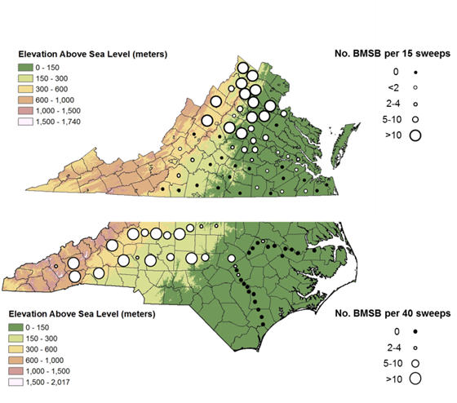
Bakken et al. 2015. Occurrence of BMSB on wild hosts in non-managed woodlands and soybeans in NC and VA. Environ. Entomol. 44: in press.

Slide 13
2004
2010
2009
2008
2011
2012
2010

Slide 14
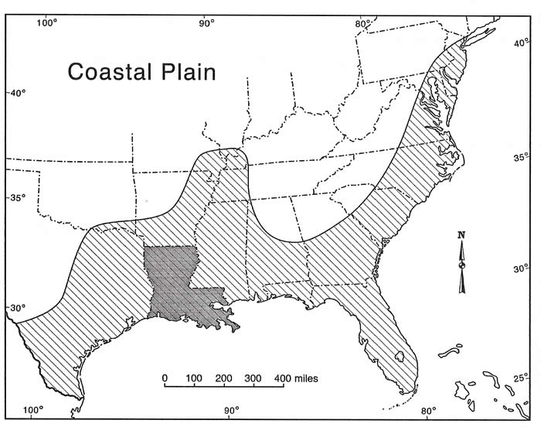

Slide 15
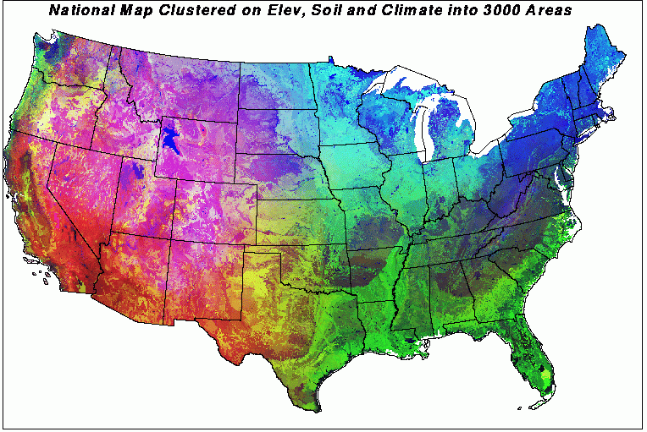
Hargrove, W.W., R.J. Luxmore. A new high-resolution national map of vegetation ecoregions produced empirically using multivariate spatial clustering. Oak Ridge National Laboratory. Oak Ridge, TN.
http://www.geobabble.org/~hnw/esri98/).

Slide 16
BMSB Research Activities in the Southeast
Kentucky (Ric Bessin)
  Exclusion netting for organic control
  Impact of biological control
  Stink bug communities in soybean
Tennessee (Jenny Moore)
  Exclusion netting for organic control
  Impact of biological control agents

Slide 17
BMSB Research Activities in the Southeast
Virginia (C. Bergh, A. Herbert, T. Kuhar, D. Pfeiffer)
  Management on tree fruit, vegetables, grapes and field crops
  Seasonal movement patterns among habitats
  Overwintering biology and ecology
  Factors affecting colonization of new habitats
  Development on different hosts
  Impact on soybeans, corn and cotton
  Organic management on vegetables
  Structural and household pest control approaches
  Development of climate models for predicting spread

Slide 18
BMSB Research Activities in the Southeast
North Carolina (J. Walgenbach, D. Reissig, G. Kennedy)
  Management on fruits, vegetables and field crops
  Impact of biologic control agents
  Overwintering biology and ecology
  Trap crops in organic systems
  Factors affecting colonization of different regions
Georgia (Mike Toews)
  Ecology of BMSB in cotton-corn-soybean agroecosystems
  BMSB damage to cotton
  Center for Invasive Species

Slide 19
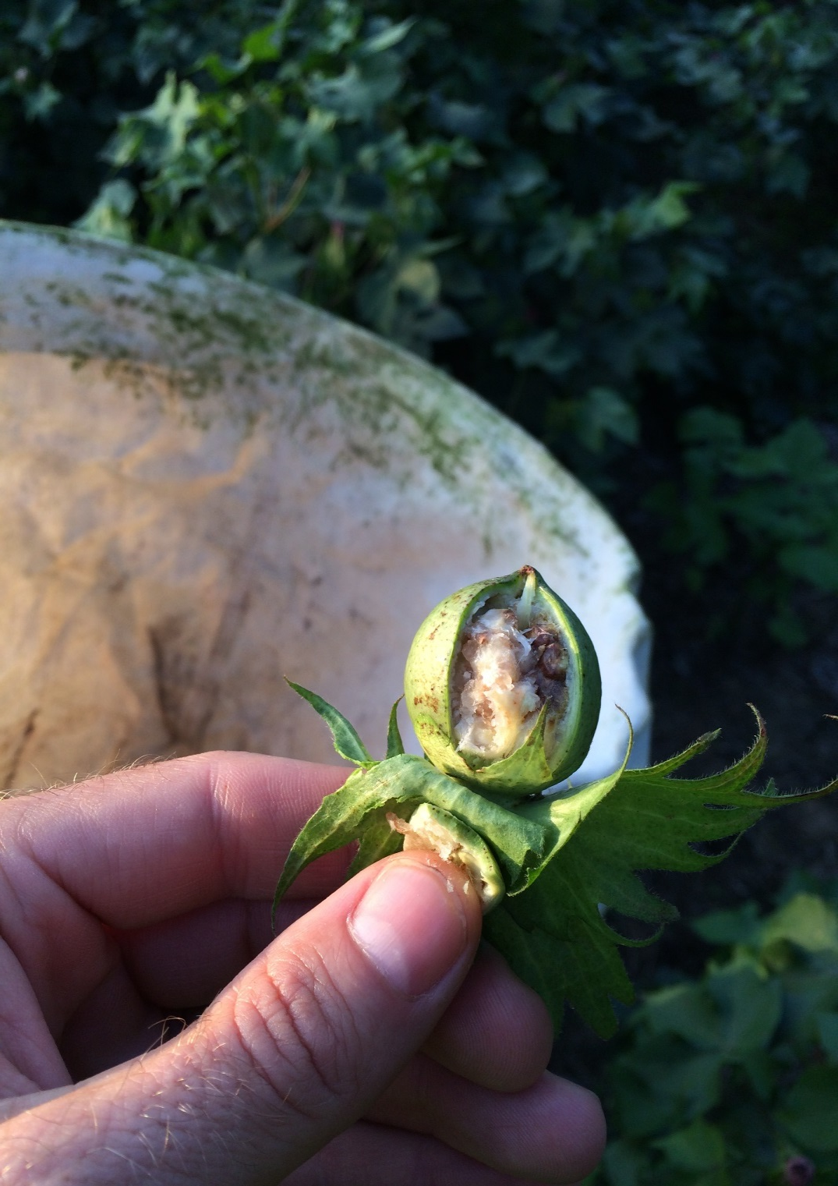
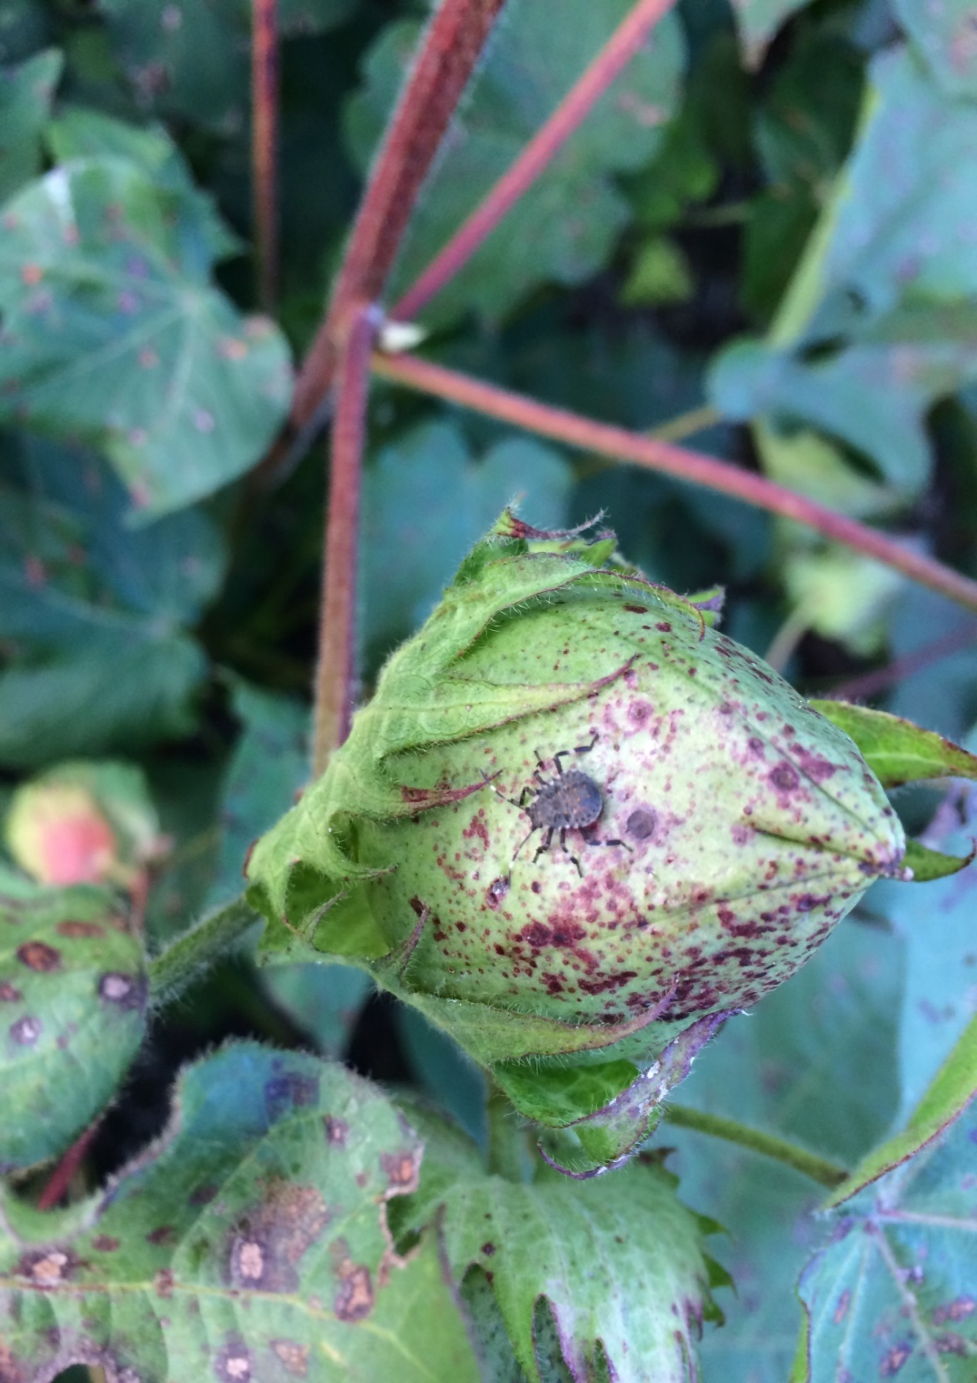
NC Cotton Field—BMSB infested—2014
D. Reisig, NCSU

Slide 20
Intensity of Brown Marmorated Stink Bug Populations in NC
ASHE
ALLEGHANY
SURRY
STOKES
ROCKINGHAM
CASWELL
PERSON
WARREN
NORTH-AMPTON
GATES
CAMDEN
CURRITUCK
GRAN-VILLE
VANCE
HERTFORD
PASQUOTANK
WATAUGA
WILKES
YADKIN
HALIFAX
CHOWAN
PERQUI-
MANS
MITCH- ELL
AVERY
FORSYTH
GUILFORD
ALA-MANCE
ORANGE
FRANKLIN
BERTIE
YANCEY
CALDWELL
ALEX-ANDER
DAVIE
DURHAM
NASH
EDGECOMBE
MADISON
IREDELL
DAVIDSON
WAKE
MARTIN
WASHING-TON
TYRRELL
DARE
BUNCOMBE
McDOWELL
BURKE
CATAWBA
ROWAN
RANDOLPH
CHATHAM
WILSON
PITT
SWAIN
HAYWOOD
LINCOLN
LEE
JOHNSTON
GREENE
BEAUFORT
HYDE
GRAHAM
HENDERSON
RUTHERFORD
CABARRUS
HARNETT
JACKSON
TRANSYL-
VANIA
POLK
CLEVELAND
GASTON
MECKLEN-BERG
STANLY
MONT-GOMERY
MOORE
WAYNE
LENOIR
CRAVEN
CHEROKEE
CLAY
MACON
RICH-MOND
CUMBER-LAND
SAMPSON
PAM-LICO
UNION
ANSON
HOKE
DUPLIN
JONES
SCOT-LAND
ONSLOW
CARTERET
ROBESON
BLADEN
PENDER
COLUMBUS
NEW
HANOVER
BRUNSWICK
Widespread agricultural and nuisance pest.
Locally intense agricultural and nuisance pest.
Local hotspots in residential areas.
Low level populations in isolated areas.
Notes:
12

